Slide 1
RADIATION ONCOLOGY · UCT / GSH REGISTRAR TRAINING
What Makes a Plan
Good?
3DCRT Plan Evaluation Workshop · Theory & Practical Module
From bad, to acceptable, to good - a structured approach
Presented by Tamerone Manasse · For UCT / GSH Registrars · 2026
3DCRT PLAN EVALUATION / THEORY MODULE
01 / 34
Notes:
OPEN THE SESSION HERE. Frame the next 30 minutes.
Say something like: "Over the coming sessions you'll score real 3DCRT plans across five anatomical sites. Before we pick up a scorecard, we need a shared language for what 'good' actually means. That's what this theory module gives you."
Make the central point early: plan evaluation is not about memorising numbers. It's a structured, repeatable way of looking at a plan so you reach the same judgement every time — and can defend it. The numbers (V95, QUANTEC constraints, CI) are tools that serve that judgement.
Housekeeping to mention: the module is 30 minutes, three 10-minute blocks — target coverage, organ-at-risk constraints, and technical quality. As we go, each registrar is building their own evaluation scorecard; we compare it against an 'ideal' scorecard at the end of each block.
Tone: this is foundational and exam-relevant — FRCR / fellowship plan-evaluation vivas lean heavily on exactly this material — but it is also day-one practical. Encourage questions throughout rather than saving them.

Slide 2
HOW THIS SESSION RUNS
Framework, three blocks, a scorecard
≈ 25 minutes theory · 90 minutes practical · FCB-CHOPS runs throughout
BY THE END YOU CAN…
Framing & FCB-CHOPS
0:00 – 0:05
The central question · framework · your task
SLIDES 1–6
▸ Apply FCB-CHOPS — a complete evaluation checklist
▸ Read a DVH and pull coverage & OAR numbers off it
▸ Explain CI & HI — and what “good enough” means
▸ Apply OAR constraints using serial / parallel logic
▸ Judge technical quality of a 3DCRT plan
Block 1 · Target Coverage
0:05 – 0:12
Is the right volume getting the right dose?
SLIDES 7–13
Block 2 · OAR Constraints
0:12 – 0:18
Is normal tissue safe — and how do we know?
SLIDES 14–18
Block 3 · Technical Quality
0:18 – 0:23
Is the plan well built and deliverable?
SLIDES 19–24
Consolidate & routine
0:23 – 0:25
Scorecard tiers · evaluation routine · close
SLIDES 25–27
3DCRT PLAN EVALUATION / THEORY MODULE
02 / 34
Notes:
WALK THE MAP so registrars always know where they are. The module is about 47 minutes across 34 slides, in five segments.
First — framing and FCB-CHOPS, roughly twelve minutes: the central question, the four-category quality spectrum, the Plan A / Plan B scenario hook, then the FCB-CHOPS checklist and the scorecard task. This segment sets up everything that follows.
Then the three teaching blocks, ten minutes each — Target Coverage, OAR Constraints, Technical Quality — each posing a single question. These go deep on the dosimetry behind the checklist.
Finally, about five minutes to consolidate: the scorecard tiers, the repeatable evaluation routine, and the close.
The six objectives on the left are what you hold them to — read them out; the verbs matter ("apply", "read numbers off", not "know about"). Make the two structures explicit: FCB-CHOPS is the checklist they will use at the workstation; the three blocks are where we build the judgement behind it. The scorecard is built continuously, block by block — the common gap is over-weighting hot spots and under-weighting OAR mean doses.
Timing discipline: if discussion runs long, compress the worked-example slides, not the concepts. The separate facilitator timing sheet has the segment-by-segment plan and a 30-minute compressed option.

Slide 3
THE CENTRAL QUESTION
A good plan answers four questions
Run every plan past these four lenses, in order. A plan is never “perfect” - it is the best defensible compromise.
01
Does it treat the target?
02
Does it spare normal tissue?
Adequate dose to the whole target volume — no geographic miss, no cold spot where tumour lives.
Every organ at risk within tolerance — judged against the right dose-volume metric for that organ.
03
Is it technically sound?
04
Is it deliverable & robust?
Sensible isocentre, beam angles, weighting and shaping — the plan is built, not just generated.
Achievable on the machine, and stable to realistic setup and anatomy variation. Undeliverable ≠ good.
3DCRT PLAN EVALUATION / THEORY MODULE
03 / 34
Notes:
THIS SLIDE IS THE SPINE OF THE WHOLE COURSE. Spend a minute here.
The four questions map onto the three blocks plus one more. Coverage = question 1. OAR constraints = question 2. Technical quality = question 3. Question 4 — deliverability and robustness — runs underneath all of them.
Teach them to ask the questions IN ORDER. Coverage first: a beautifully OAR-sparing plan that misses the tumour is not a good plan, it is a dangerous one. Only once the target is covered do you ask what it cost the normal tissue. Then you ask whether the plan is technically well constructed. Then — could this actually be delivered, and does it hold up if the patient is 5 mm off or their bladder fills differently tomorrow.
Hammer the word COMPROMISE. There is almost never a perfect plan. Coverage and sparing pull against each other; that tension is the whole job. A good plan is the best defensible balance, and 'defensible' means you can articulate every compromise you accepted and why.
Ask the room: "Question 4 — why isn't a plan that looks perfect on screen automatically good?" Draw out answers: 700 MU of modulation the linac handles poorly; a plan that only works if the patient never moves; breath-hold the patient cannot sustain. Robustness is part of quality, not an afterthought.

Slide 4
THE REALITY OF PLAN EVALUATION
Bad, acceptable, trade-off - or good?
Few plans are clearly bad. The hard - and teachable - judgement lives in the middle two categories.
CLEARLY BAD
ACCEPTABLE
TRADE-OFF
GOOD
Unsafe or unacceptable. Easy to spot, easy to reject.
Passes constraints — but a better plan is clearly achievable.
Competing priorities pull against each other. Needs judgement.
Balanced, robust and clinically appropriate.
THE GUT-CHECK
“Would I confidently treat my own family member with this plan?”
If the answer is not a clear yes - name exactly what would have to change.
3DCRT PLAN EVALUATION / THEORY MODULE
04 / 34
Notes:
THIS RESETS WHAT EVALUATION IS FOR. Registrars expect plans to be simply pass or fail. Reality is four categories.
Clearly bad plans are uncommon and easy — unsafe, a geographic miss, an OAR grossly over tolerance: reject. Genuinely good plans are also clear. The entire skill being trained lives in the MIDDLE TWO categories, and registrars must learn to tell them apart.
An "acceptable but not optimal" plan meets every constraint on paper — yet a better plan is clearly achievable, and accepting the mediocre one is a quiet failure. A "trade-off" plan is different: competing priorities genuinely pull against each other — tighten coverage and you cost an OAR, spare the OAR and coverage softens — and there is no free improvement, only a judgement call. Confusing the two is the classic registrar error: treating a fixable, lazy plan as an unavoidable trade-off, or agonising over a true trade-off as if there were a perfect answer.
THE GUT-CHECK question is the emotional anchor of the whole module — say it slowly. "Would I confidently treat my own family member with this plan?" It cuts straight through the false reassurance of a tidy-looking DVH. And make the follow-up explicit: if the answer is not a clear yes, the task is not vague unease — it is to name precisely what would have to change. That specificity is what separates a clinician from a checklist.

Slide 5
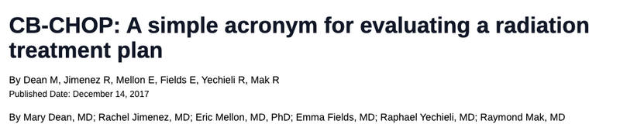
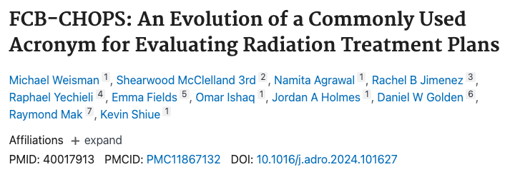
A SYSTEMATIC FRAMEWORK
FCB-CHOPS - a checklist for every plan
Eight checkpoints so no critical step is missed.
F
Fusion/Imaging
Contours
HOW TO USE IT
C
The acronym exists so no critical step is missed - not so you march rigidly from F to S. Work in whatever order the plan demands; the letters are a safety net, not a script.
B
Beam Arrangement
C
Coverage
H
Heterogeneity/Hotspots
START WITH THE PRESCRIPTION
It defines treatment intent, dose, fractionation, technique and priorities. Every downstream judgement flows from it - so confirm it before anything else.
O
Organs at Risk
P
Prescription
S
Summation
3DCRT PLAN EVALUATION / THEORY MODULE
05 / 34
Notes:
INTRODUCE FCB-CHOPS as the structured checklist that guarantees nothing is missed. It is a published, recognised acronym (Weisman et al., Advances in Radiation Oncology, 2024) — worth knowing by name.
Walk the eight steps. Fusion / imaging — is the image registration correct, so target and OARs sit where you think. Contours — are the target and OAR outlines complete and anatomically right; a plan can only ever be as good as its contours. Beam arrangement — is the geometry sensible. Coverage — is the target actually getting the dose. Heterogeneity / hotspots — is the internal dose variation acceptable, no dangerous hot or cold regions. Organs at risk — are the OAR constraints respected. Prescription — is the dose, fractionation and technique correct. Summation — has dose from previous or concurrent courses been accounted for.
The colour coding deliberately previews the rest of the module. The orange steps — Fusion, Contours, Beams — are the geometric inputs and technique, which Block 3 covers. The cyan steps — Coverage and Heterogeneity — are Block 1. The green step — Organs at risk — is Block 2. The two dark steps — Prescription and Summation — run across everything and are never "one block".
Frame the relationship clearly: FCB-CHOPS is the WHAT-TO-CHECK. The three teaching blocks are the HOW-TO-JUDGE what you find. A registrar needs both — a checklist with no judgement misses subtle problems; judgement with no checklist misses whole categories.

Slide 6
A SYSTEMATIC FRAMEWORK
FCB-CHOPS - a checklist for every plan
F
Fusion/Imaging: Verify image fusion accuracy to ensure correct target and OAR anatomy.
C
Contours: Check that all target and OAR contours are complete and anatomically correct.
B
Beam Arrangement: Confirm that beam geometry and entry points are appropriate for the target.
C
Coverage: Ensure the prescribed dose adequately covers the target volume.
H
Heterogeneity/Hotspots: Assess internal dose variation for acceptable high and low dose regions.
O
Organs at Risk: Check that OAR doses respect clinical constraints.
P
Prescription: Confirm the correct dose, fractionation, and delivery schedule are used.
S
Summation: Evaluate cumulative dose from all treatment courses / previous RT (if applicable).
3DCRT PLAN EVALUATION / THEORY MODULE
06 / 34
Notes:
INTRODUCE FCB-CHOPS as the structured checklist that guarantees nothing is missed. It is a published, recognised acronym (Weisman et al., Advances in Radiation Oncology, 2024) — worth knowing by name.
Walk the eight steps. Fusion / imaging — is the image registration correct, so target and OARs sit where you think. Contours — are the target and OAR outlines complete and anatomically right; a plan can only ever be as good as its contours. Beam arrangement — is the geometry sensible. Coverage — is the target actually getting the dose. Heterogeneity / hotspots — is the internal dose variation acceptable, no dangerous hot or cold regions. Organs at risk — are the OAR constraints respected. Prescription — is the dose, fractionation and technique correct. Summation — has dose from previous or concurrent courses been accounted for.
The colour coding deliberately previews the rest of the module. The orange steps — Fusion, Contours, Beams — are the geometric inputs and technique, which Block 3 covers. The cyan steps — Coverage and Heterogeneity — are Block 1. The green step — Organs at risk — is Block 2. The two dark steps — Prescription and Summation — run across everything and are never "one block".
Frame the relationship clearly: FCB-CHOPS is the WHAT-TO-CHECK. The three teaching blocks are the HOW-TO-JUDGE what you find. A registrar needs both — a checklist with no judgement misses subtle problems; judgement with no checklist misses whole categories.

Slide 7
01
Target Coverage
10 MINUTES
How to read a dose volume histogram
Coverage metrics - V95, V107, D98, D2, D50
BLOCK ONE
Conformity and homogeneity - and “what is good enough?”
3DCRT PLAN EVALUATION / THEORY MODULE
07 / 34
Notes:
BLOCK 1 — TARGET COVERAGE. Ten minutes.
Transition line: "We start with question one, because it comes first clinically — does the plan actually treat the disease."
Preview what is coming: the DVH as the core tool, the handful of coverage numbers worth knowing, the two indices — conformity and homogeneity — and then the judgement question that everything builds to: what is good enough? Coverage is where registrars are usually most comfortable, so move briskly; you want time banked for blocks 2 and 3.
One framing thought to plant now: coverage is the question with the clearest 'right answer' on paper — yet it is also the one where rigid number-chasing does the most harm, because pushing coverage always costs normal tissue somewhere. Hold that tension; we resolve it on the 'good enough' slide.

Slide 8
BLOCK 1 · TARGET COVERAGE
First, name your volumes
Coverage means nothing until you are clear on which volume you are covering. The ICRU volume hierarchy (Reports 50, 62, 83):
GTV
CTV
ITV
PTV
Gross Tumour Volume
→
Clinical Target Volume
→
Internal Target Volume
→
Planning Target Volume
What you can see, palpate or image. No tumour = no GTV.
GTV + suspected microscopic spread. The true clinical target.
CTV + internal motion (e.g. breathing). ICRU 62.
ITV/CTV + set-up uncertainty. A geometric safety margin.
THE POINT THAT MATTERS FOR EVALUATION
We prescribe to and evaluate dose on the PTV — but the clinical aim is to cover the CTV. The PTV is not tissue; it is a margin that protects the CTV against uncertainty. A small PTV-edge underdose may still leave the CTV fully covered.
3DCRT PLAN EVALUATION / THEORY MODULE
10 / 34
Notes:
QUICK FOR A MIXED ROOM — most will know this, but the evaluation point at the bottom is the one people get wrong, so do not skip it.
Run the hierarchy: GTV is gross, demonstrable disease — see it, feel it, image it. No demonstrable tumour (e.g. post-operative) means no GTV. CTV adds the margin for microscopic spread you cannot see but know is there — a clinical, biological judgement. ITV adds internal motion, the classic example being respiratory motion of a lung CTV (ICRU 62). PTV adds set-up uncertainty — patient positioning, machine tolerance — and is a purely geometric construct.
THE EVALUATION POINT, bottom of the slide: we prescribe to the PTV and we evaluate coverage on the PTV — but the PTV is not a thing in the patient. It is a margin. The clinical aim is the CTV. Why this matters: when you see a PTV V95 of, say, 93%, the underdose is usually at the PTV periphery — which is the uncertainty margin. The CTV may well still be fully covered. So a PTV coverage 'fail' is a prompt to look WHERE the cold region sits, not an automatic re-plan.
The flip side: a cold spot that reaches into the CTV — into tissue that genuinely harbours tumour — is far more serious than the same volume of cold at the PTV edge. The DVH gives you the number; the isodoses on the slices tell you which volume the cold actually lives in. That distinction recurs all module.
Mention PRV in passing — the OAR equivalent of the PTV — we develop it properly in Block 2.

Slide 9
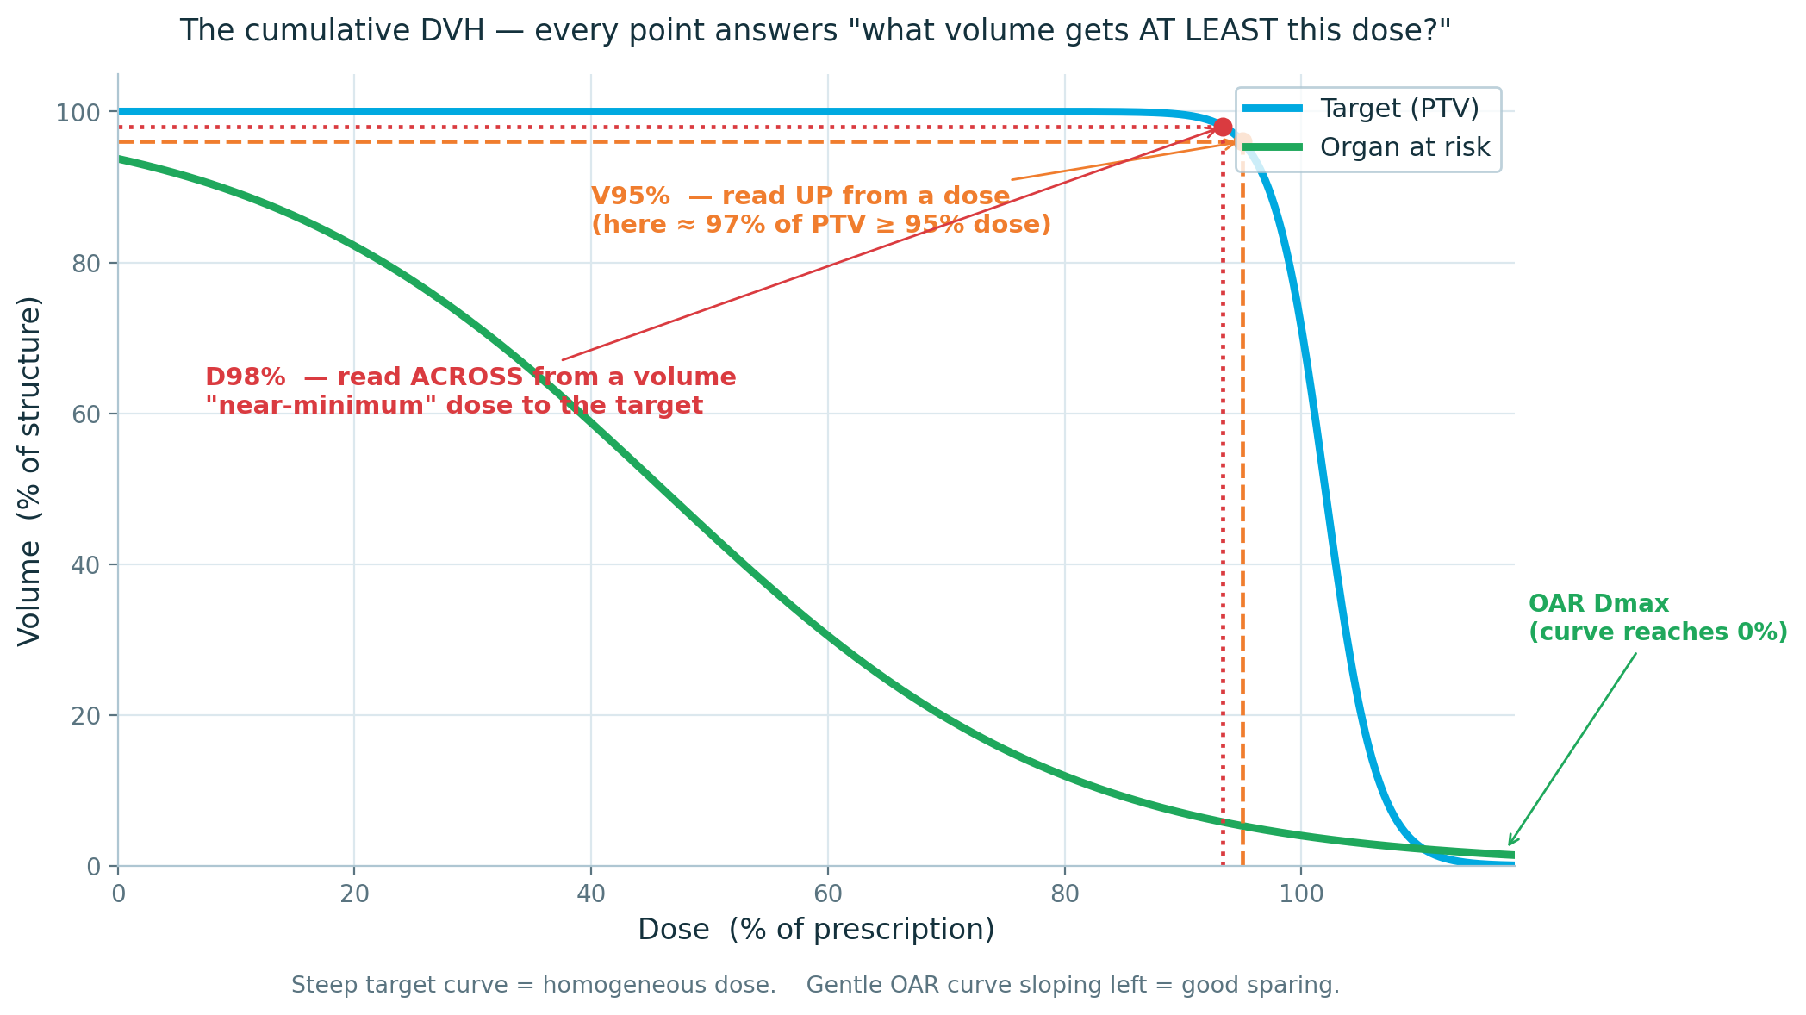
BLOCK 1 · TARGET COVERAGE
The DVH - your primary instrument
The cumulative dose–volume histogram collapses a 3-D dose distribution into one readable curve.
▸ Every point answers one question: what volume gets at least this dose?
▸ Read up from a dose → a V-metric
▸ Read across from a volume → a D-metric
▸ Steep target curve = homogeneous full-dose coverage
▸ OAR curve hugging the origin = good sparing
Limitation: a DVH has no spatial information. It never tells you WHERE.
Cumulative DVH — target (blue) and an organ at risk (green)
3DCRT PLAN EVALUATION / THEORY MODULE
09 / 34
Notes:
THE DVH IS THE SINGLE MOST IMPORTANT TOOL IN THE MODULE. Make sure everyone can genuinely read one — not just nod along.
What it is: a cumulative dose-volume histogram takes the entire 3-D dose distribution inside a structure and collapses it to one curve. The x-axis is dose; the y-axis is the percentage (or absolute volume) of the structure. "every point on the curve answers, what volume of this structure receives AT LEAST this dose."
Read UP from a dose on the x-axis to the curve — that gives a V-metric (a volume at a dose), e.g. V95. Read ACROSS from a volume on the y-axis — that gives a D-metric (a dose at a volume), e.g. D98. Walk the projected diagram: trace the orange V95 construction, then the red D98 construction.
Curve SHAPES carry meaning before you read a single number. A target curve should sit flat near 100% and then drop almost vertically — flat-then-cliff means the whole target gets close to full dose, i.e. homogeneous coverage. An OAR curve should fall away towards the origin — pulled down and to the left means most of the organ sees little dose. A registrar should be able to glance at a DVH and form an impression in two seconds, then confirm with numbers.
THE LIMITATION is critical and registrars forget it constantly: the DVH has thrown away all spatial information. It tells you THAT 6% of the PTV is cold; it cannot tell you WHERE. Two plans with identical DVHs can be clinically miles apart — cold dispersed harmlessly at the PTV edge versus cold as one solid block through the tumour bed. Always, always cross-check the isodose lines on the axial slices. The DVH screens; the slices diagnose.

Slide 10
BLOCK 1 · TARGET COVERAGE
Coverage metrics - the numbers that matter
V95%
V107%
Volume of the PTV receiving ≥ 95% of the prescribed dose.
Volume receiving ≥ 107% — the high-dose / hot-spot volume.
Standard aim: V95 ≥ 95% of the PTV. Some protocols want ≥ 98% for the GTV.
ICRU 83: keep small - workshop target < 2% of PTV, and ideally inside the target.
THE MODERN WAY TO STATE COVERAGE — ICRU 83
ICRU 83 prefers dose-at-a-volume (D95% — the dose covering 95% of the PTV) over volume-at-a-dose. Both are in daily use; what matters is that you state which volume and which dose level. “V95” is meaningless until you say V95 of the PTV at the 95% isodose.
3DCRT PLAN EVALUATION / THEORY MODULE
10 / 34
Notes:
THE COVERAGE VOCABULARY. Keep it tight — there are really only a few numbers worth memorising.
V95 — the volume of the PTV receiving at least 95% of the prescribed dose. This is the workhorse coverage number. The conventional aim is V95 of the PTV at or above 95%. The '95% of prescription' threshold exists because we accept the dose will not be perfectly uniform; 95% is a pragmatic floor for 'effectively treated'. Some protocols are stricter on the gross disease — V98 or even V100 of the GTV.
V107 — the volume receiving 107% or more; the hot-spot or high-dose volume. ICRU 83's logic: a near-maximum dose (D2%) above about 107% is a meaningful hot spot. We want the high-dose volume small, and — this is the part registrars miss — we care WHERE it sits. A hot spot inside the PTV is usually fine; the same hot spot in skin or an OAR is not. We return to this in Block 3.
THE MODERN FRAMING, bottom panel: ICRU 83 actually prefers you quote D-at-volume rather than V-at-dose — D95%, the dose that covers 95% of the PTV, D98% as near-minimum, D2% as near-maximum. The reason is statistical robustness, which is the next slide. In practice you will see both V-metrics and D-metrics on plans, and both are fine.
The discipline to drill: a coverage number is meaningless without its structure and its dose level. "V95 is 96%" tells me nothing. "V95 of the PTV, at the 95% isodose, is 96%" is a statement I can evaluate. Make them say the full phrase until it is automatic — vague coverage statements are a classic viva failure.

Slide 11
BLOCK 1 · TARGET COVERAGE
D98 / D2 / D50 — why point doses retired
D98%
D2%
D50%
NEAR-MINIMUM
NEAR-MAXIMUM
MEDIAN DOSE
Dose received by 98% of the volume. The robust stand-in for Dmin.
Dose received by 2% of the volume. The robust stand-in for Dmax.
Dose to half the volume — the denominator of the homogeneity index.
WHY NOT JUST USE Dmin AND Dmax?
Dmin and Dmax are single-voxel point doses. A lone voxel is statistically noisy — it shifts with calculation grid size, resolution and contouring jitter, so it is not reproducible. ICRU 83 replaced them with D98% and D2%: near-minimum and near-maximum doses that mean almost the same thing clinically but are stable plan-to-plan and scanner-to-scanner. Trust a near-max over a Dmax.
3DCRT PLAN EVALUATION / THEORY MODULE
13 / 34
Notes:
A SHORT, HIGH-VALUE SLIDE — it explains a 'why' that registrars rarely have articulated, and it is good viva fodder.
The three D-statistics: D98% is the dose received by 98% of the volume — effectively the minimum, hence 'near-minimum'. D2% is the dose received by 2% of the volume — effectively the maximum, hence 'near-maximum'. D50% is the dose to half the volume — the median — and it is the denominator of the homogeneity index which we will discuss later.
Why did ICRU 83 move away from plain Dmin and Dmax? Because a true minimum or maximum is a single-voxel point dose. One voxel. That value is statistically fragile: change the dose calculation grid from 3 mm to 2 mm and it moves; change CT resolution and it moves; a one-voxel contouring wobble and it moves. So Dmax is not reproducible — your Dmax and mine on the same plan can differ.
D98 and D2 average over a small but real slab of tissue — 2% of the volume — so they are stable. They carry essentially the same clinical meaning (is anywhere getting too little? too much?) without the noise.
We need to ask ourselves is the hotspot clinically significant or is it just a single voxel that can change with the grid size?
Practical aside: this is also why you should not panic at a Dmax of, say, 109% sitting on one voxel. Look at D2%. If D2% is 104%, the '109%' is a single hot voxel and largely an artefact. The near-max tells you whether there is a real, clinically meaningful hot region.

Slide 12
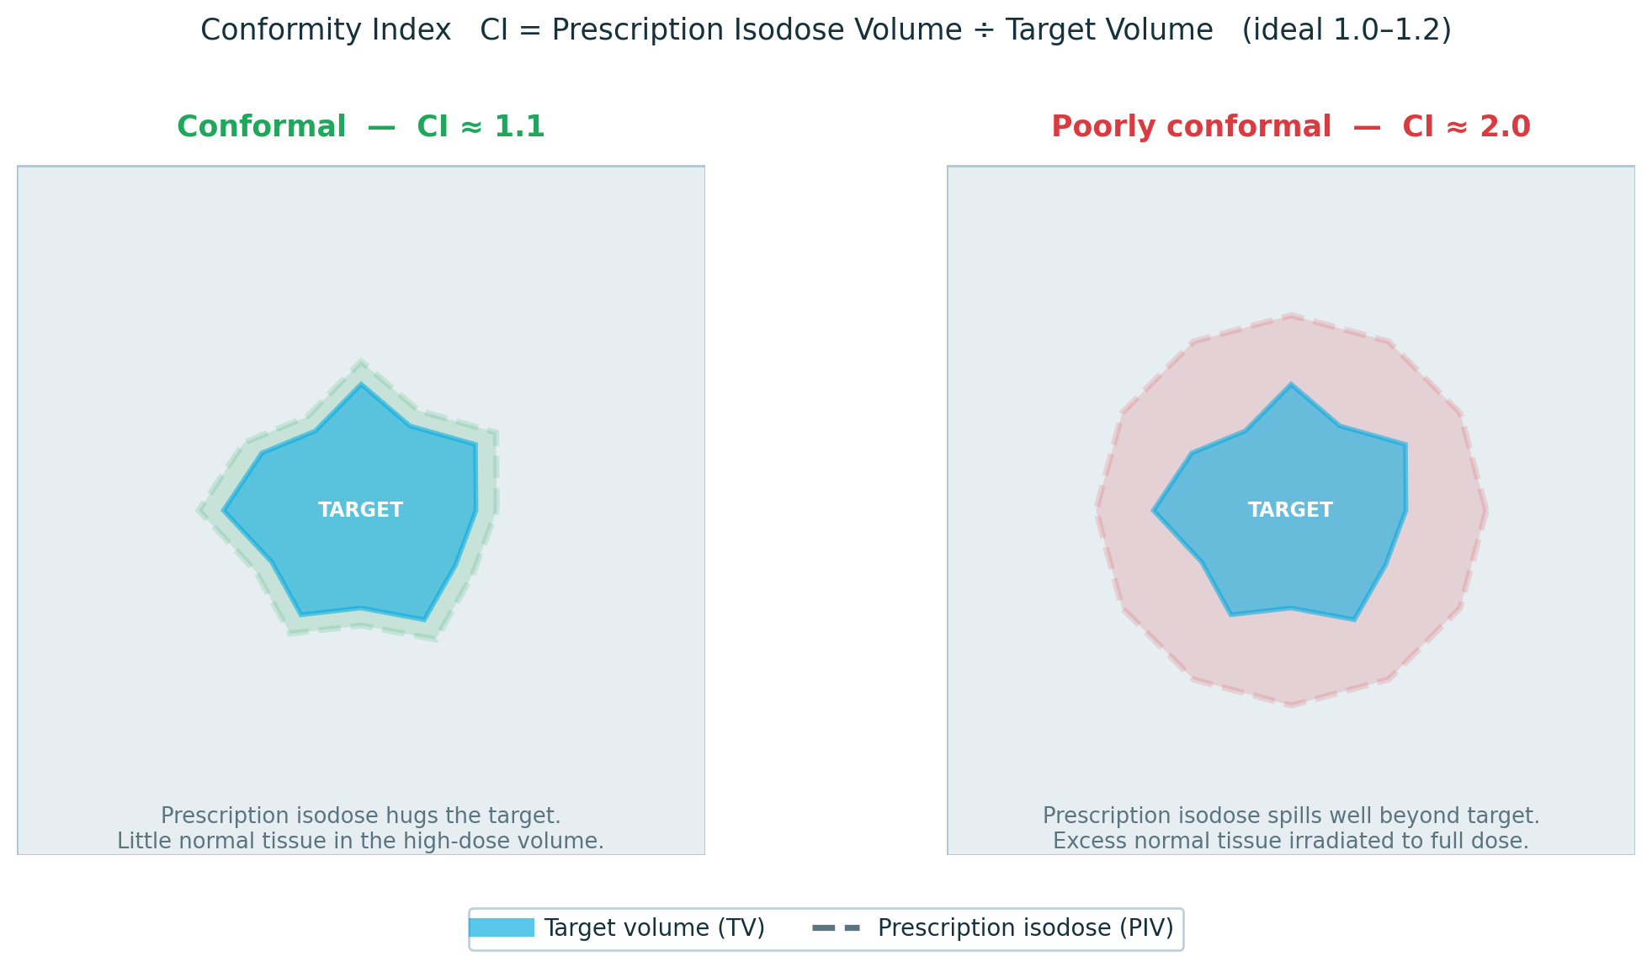
BLOCK 1 · TARGET COVERAGE
Conformity — is the dose the right shape?
Conformity asks: does the prescription dose wrap the target — or is it spilling into normal tissue?
Look at the isodose lines on every slice.
The prescription isodose should hug the target — not bulge out beyond it or fall short of it.
Good — isodose closely follows the target outline on most slices
Marginal — dose bulges noticeably beyond the target in places; more normal tissue than needed is included
Poor — isodose falls short of the target or misses an edge entirely; target is underdosed
3DCRT context: shaped static beams cannot wrap dose as tightly as VMAT — some bulge beyond the target is expected and acceptable. Judge what you see against the technique, not an abstract ideal.
3DCRT PLAN EVALUATION / THEORY MODULE
11 / 34
Notes:
CONFORMITY — the core question: does the dose wrap the target, or is it spilling?
The question you want registrars asking at the screen is simple: look at the prescription isodose on each slice — does it hug the target, or does it wander away from it? That visual judgement is the skill. The number is just a shorthand for what the eye can already see.
What a good plan looks like: The prescription isodose closely follows the target outline. There may be a small margin of normal tissue included — that is expected — but there are no large bulges out toward a nearby OAR and the target is fully enclosed on every slice.
What a bad plan looks like: Either the dose cloud is clearly bigger than the target — irradiating a lot of tissue that doesn't need it — or there are slices where the isodose falls short of the target edge, meaning part of the tumour is getting less than prescription dose. Either is a problem worth flagging.
The trade-off conversation: Sometimes you cannot get a tight wrap without pushing dose into a critical structure. That is a legitimate trade-off, not a failure — but the planner and clinician need to have made that decision consciously. A registrar spotting the bulge and asking "was that a deliberate choice?" is exactly the right question.
3DCRT context — reassure them: Shaped static beams cannot conform as tightly as VMAT. Some overshoot is inherent to the technique. So a 3DCRT plan will always look slightly looser than an equivalent IMRT or VMAT plan — that is not a fault, it is physics. Judge what you see against what 3DCRT can realistically achieve, not against an IMRT benchmark.
How to fix a conformity problem: Tighten field apertures or MLCs to reduce the bulge. Check beam angles — a poorly chosen angle may force the field to include more normal tissue to cover the target. If a specific direction is the problem, consider adding or rotating a beam. These are the conversations to drive in case review.

Slide 13
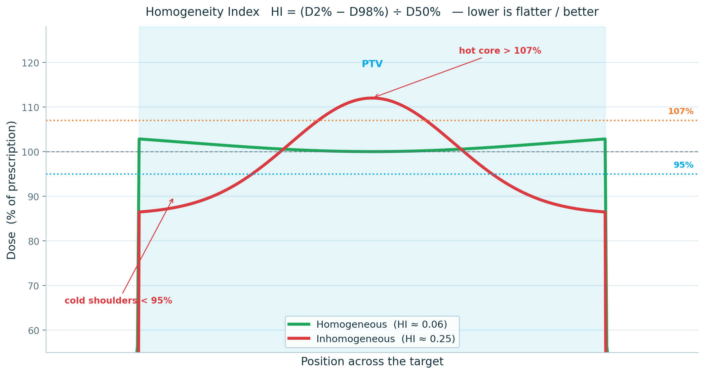
BLOCK 1 · TARGET COVERAGE
Homogeneity — is the dose evenly spread?
Homogeneity asks whether dose is uniform across the target — no hot core, no cold shoulders.
HI = (D2% − D98%) ÷ D50%
▸ Lower is flatter — ICRU 83; ideal near 0, < 0.1 good
▸ Hot spots → normal-tissue toxicity
▸ Cold spots → risk of local recurrence
▸ 3DCRT tools — wedges, field-in-field, compensators
Note: SBRT deliberately runs inhomogeneous — a hot core is intended.
3DCRT PLAN EVALUATION / THEORY MODULE
12 / 34
Notes:
HOMOGENEITY — not the shape of the dose but its UNIFORMITY across the target.
The ICRU 83 homogeneity index: D2% minus D98%, divided by D50%. In words — the spread between the near-maximum and the near-minimum, normalised to the median. A perfectly uniform target dose would give D2 = D98 and an HI of 0. So lower is flatter is better; an HI under about 0.1 is good. Be aware other definitions float around — Dmax over prescription, D5 over D95 — so when someone quotes an HI, check which formula. The ICRU 83 version is the one to teach.
Why uniformity matters clinically, both directions. A hot spot — a region well above prescription — drives normal-tissue toxicity, especially if it lands in or near an OAR. A cold spot — a region below prescription inside the target — is a potential site of local recurrence; that is tumour being underdosed. An inhomogeneous plan is therefore failing at both ends at once. Point at the diagram: the green profile is flat across the PTV; the red one has a hot core above 107% and cold shoulders dipping under 95% — the same plan is simultaneously too hot and too cold.
How you fix homogeneity in 3DCRT specifically — and this previews Block 3 — wedges to compensate for sloping patient surface, field-in-field segments to push down hot spots, physical or electronic compensators. These are your 3DCRT modulation tools; we cover them properly later.
THE EXCEPTION, bottom panel — do not let them over-generalise. SBRT deliberately runs inhomogeneous. Stereotactic plans often prescribe to a low isodose, the 70 or 80%, leaving a hot core of 120%+ inside the GTV on purpose, exploiting a steep dose fall-off. So 'homogeneous is good' is a conventionally fractionated 3DCRT rule, not a universal law. Always evaluate homogeneity against the intent of the technique.

Slide 14
BLOCK 1 · TARGET COVERAGE
“What is good enough?”
Coverage numbers are not pass/fail laws. They are negotiated — against OAR safety, intent and what the technique can deliver.
Coverage is negotiable
Know where the cold sits
Where the PTV abuts a serial OAR, you accept a small underdose at the overlap rather than breach a hard tolerance. Safety wins.
Underdose at the PTV margin may leave the CTV intact. Underdose reaching into the CTV is a different, serious problem.
Intent sets the bar
Achievable, not ideal
Radical treatment demands tighter coverage than palliation. “Good enough” for pain relief is not “good enough” for cure.
Judge against what 3DCRT can realistically do for this anatomy — not against an inverse-planned VMAT distribution.
3DCRT PLAN EVALUATION / THEORY MODULE
13 / 34
Notes:
THE JUDGEMENT SLIDE OF BLOCK 1 — and the antidote to mechanical number-chasing. Slow down here.
Registrars arrive wanting a rule: V95 ≥ 95% or fail. Real plan evaluation does not work like that. Coverage targets are negotiated, against four things on this slide.
Coverage is negotiable against safety. The commonest scenario: the PTV abuts a serial organ at risk — spinal cord, optic chiasm, brainstem. You cannot give the overlap full dose without breaching a hard tolerance. The correct plan deliberately underdoses the sliver of PTV that overlaps the cord. That is not a defective plan; it is a correct clinical decision, and it must be documented. Safety wins over the last few percent of coverage.
Know where the cold sits — this is slide 6 again, and it is worth repeating because it is so often wrong. A V95 of 93% with the cold dispersed at the PTV periphery may leave the CTV fully covered, because the PTV periphery is the uncertainty margin. The same 93% with the cold as one block reaching into the CTV is a geographic miss. Identical number; different plans. The DVH flags it; the slices tell you which it is.
Intent sets the bar. A radical, curative plan demands tight coverage — you are trying to sterilise every clonogen. A palliative plan for bone pain has a completely different bar; getting adequate dose to the painful site quickly and safely is the goal, and chasing a homogeneity index there wastes everyone's time. Match your standard to the clinical intent.
Achievable, not ideal. Evaluate the plan against what 3DCRT can realistically achieve for THIS anatomy. A few shaped beams will never match an inverse-planned VMAT distribution around a concave target — and they are not meant to. The question is never 'is this the best conceivable distribution' but 'is this the best defensible plan for this patient with this technique'.
Close the block: good enough is a clinical judgement, supported by numbers — never replaced by them.

Slide 15
02
OAR Constraints
10 MINUTES
Serial vs parallel organs — architecture decides the metric
Tolerance doses, QUANTEC and dose–response
BLOCK TWO
Clinical context, modifiers and the PRV
3DCRT PLAN EVALUATION / THEORY MODULE
14 / 34
Notes:
BLOCK 2 — ORGAN-AT-RISK CONSTRAINTS. Ten minutes.
Transition: "Block 1 asked whether the plan treats the disease. Block 2 asks what that treatment costs the normal tissue — and, just as importantly, how we KNOW."
Preview the logic chain, because this block is more conceptual than Block 1 and registrars do better if they see the structure first: organ ARCHITECTURE (serial vs parallel) tells you which DVH metric to read; the EVIDENCE (Emami, then QUANTEC) tells you the threshold for that metric; the DOSE-RESPONSE curve tells you how forgiving or unforgiving that threshold is; and clinical CONTEXT — re-irradiation, chemotherapy, comorbidity — modifies all of it.
Set the expectation: the goal is not to memorise a table of numbers. It is to understand WHY a constraint takes the form it does, so that when you meet an unfamiliar organ or an unusual clinical situation you can reason rather than recall. That reasoning is what the block is really teaching.

Slide 16
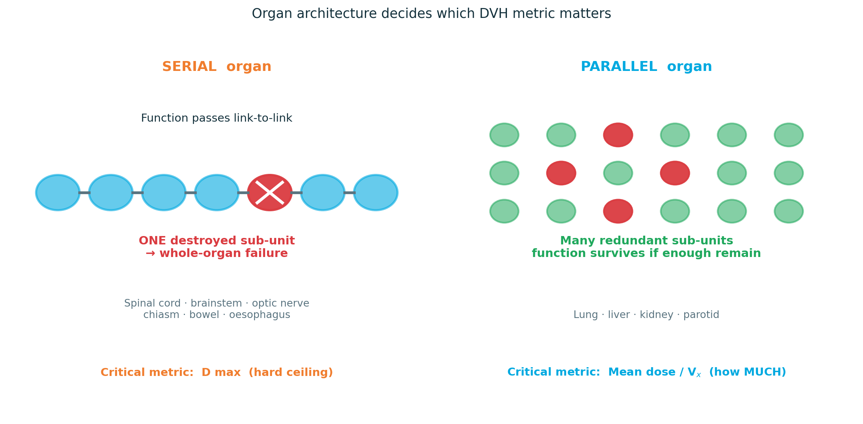
BLOCK 2 · OAR CONSTRAINTS
Serial vs parallel — architecture sets the rule
How an organ is wired decides which number on the DVH actually matters.
SERIAL
One destroyed sub-unit fails the whole organ. Governed by Dmax.
PARALLEL
Redundant sub-units; function survives if enough remain. Governed by mean dose / Vx.
3DCRT PLAN EVALUATION / THEORY MODULE
15 / 34
Notes:
THE CONCEPTUAL KEYSTONE OF BLOCK 2. If they leave with one idea from this block, make it this one.
The functional-subunit model. Picture an organ as built from many small functional subunits, and ask how they are wired together.
SERIAL organs — subunits in series, like links in a chain or lights in old-style series fairy lights. Function has to pass through every link. Destroy ONE critical subunit and everything downstream fails — the whole chain is broken. The clinical archetype is the spinal cord: a tiny volume taken above tolerance can cause myelopathy, and it does not matter that the rest of the cord had a beautiful low dose. Other serial structures: brainstem, optic nerves and chiasm, bowel, oesophagus. Because the single worst point is what matters, the governing metric is the MAXIMUM dose — Dmax, or a near-max to a small absolute volume like D0.03cc or D1cc. Serial organ thinking is 'hard ceiling' thinking.
PARALLEL organs — subunits independent and redundant, wired side by side. Lose some and the organ keeps working, because the survivors carry the load; the organ only fails when you have destroyed enough of it to fall below a functional reserve. The archetype is lung: ablate a small region and the patient is fine; irradiate a large fraction and you get pneumonitis. Also liver, kidney, parotid. Here the single worst point is almost irrelevant — what matters is HOW MUCH of the organ was hit. So the governing metric is the MEAN dose, or a volume metric — Vx, the volume above a threshold dose. Parallel organ thinking is 'how much' thinking.
The punchline, and write it on the board: ARCHITECTURE DECIDES THE METRIC. Before you read any number off an OAR's DVH, ask — is this organ serial or parallel? That tells you whether to look at the Dmax or the mean. Quoting a mean dose for the spinal cord, or a Dmax for the lung, shows you have not understood the organ.
One honest caveat: many organs are intermediate. Rectum behaves partly serially, partly in parallel, which is why it carries a whole series of Vx constraints rather than a single number. Heart is similar. Real organs sit on a spectrum — but serial-versus-parallel is the mental model that makes every constraint table make sense.

Slide 17
BLOCK 2 · OAR CONSTRAINTS
Tolerance doses — where the limits come from
1991
2010
NOW
Emami
QUANTEC
Protocol sets
First systematic tolerance table — TD5/5 and TD50/5 for 1/3, 2/3 and whole-organ volumes. Largely expert consensus.
Quantitative Analysis of Normal Tissue Effects in the Clinic — evidence-based, organ-by-organ dose–volume limits with defined endpoints. The working reference.
RTOG / NRG and national protocol constraints; HyTEC for hypofractionation and SBRT. Always plan to the named protocol.
THE CAVEAT THAT MATTERS
Most QUANTEC data come from conventionally fractionated 3DCRT (~1.8–2 Gy per fraction). Constraints assume that schedule. Change the fractionation, or re-irradiate, and you must think in BED / EQD2 — never read a 2 Gy/fraction number straight onto an SBRT plan.
3DCRT PLAN EVALUATION / THEORY MODULE
16 / 34
Notes:
WHERE THE NUMBERS COME FROM. Registrars quote QUANTEC constantly; few know what it actually is or what it rests on. Fix that.
Emami, 1991. The first attempt to put normal-tissue tolerance into one systematic table. It introduced the language we still use: TD5/5 — the dose expected to give a 5% complication rate at 5 years — and TD50/5, the dose for a 50% rate at 5 years, tabulated for one-third, two-thirds and whole-organ irradiation. Crucial honest point: Emami was, by necessity, largely expert consensus — the dose-volume data of the modern era simply did not exist in 1991. It was a landmark, and it was a best guess.
QUANTEC, 2010 — Quantitative Analysis of Normal Tissue Effects in the Clinic, published as a supplement to the Red Journal. This is the step change: organ-by-organ reviews of the actual 3D dose-volume outcome data, each giving constraints tied to a DEFINED endpoint — not just 'lung tolerance' but 'mean lung dose and the risk of symptomatic pneumonitis'. QUANTEC is the everyday working reference and is heavily examined; know a handful of its headline numbers — cord, lung, parotid, rectum.
Now — protocol-specific constraint sets. RTOG/NRG trial protocols and national protocols each carry their own vetted constraint lists, and HyTEC does for hypofractionation and SBRT what QUANTEC did for conventional treatment. The practical rule: if a patient is being treated on a named protocol, you evaluate against THAT protocol's constraints, not a generic table.
THE CAVEAT, bottom panel — this is the one that catches people out. Almost all QUANTEC data come from conventionally fractionated 3DCRT, around 1.8 to 2 Gy per fraction, and the constraints silently assume that schedule. You cannot take a 2 Gy/fraction tolerance number and read it straight onto an SBRT plan delivering 18 Gy in a single fraction — the biology is completely different. The moment fractionation changes, or you are re-irradiating, you have to convert into biologically effective dose or EQD2 to compare like with like. Flag BED/EQD2 as essential background; a dedicated radiobiology session covers the arithmetic.

Slide 18
BLOCK 2 · OAR CONSTRAINTS
Match the metric to the organ
Read the constraint, identify the organ type, then pull the matching number off the DVH. Mismatched metrics are a classic error.
Dmax / near-max
Serial organs — spinal cord, brainstem, optic chiasm & nerves
D0.03cc · D1cc
Mean dose
Parallel organs — parotid (xerostomia), lung (pneumonitis), liver, kidney
Dmean
Volume at a dose
Threshold / mixed organs — lung V20, rectum V70 & V50, heart V25
Vx Gy
Dose to a sub-volume
Near-max to a small absolute volume — robust for serial structures
Dx cc
3DCRT PLAN EVALUATION / THEORY MODULE
17 / 34
Notes:
THE PRACTICAL PAYOFF of the serial-versus-parallel slide — turning architecture into the right number to read.
The workflow, every time: read the constraint as written, identify what TYPE of organ it is, then pull the matching metric off the DVH. Four metric families.
Dmax and near-max — D0.03cc, D1cc. For SERIAL organs: spinal cord, brainstem, optic chiasm and nerves. You care about the single worst point, so you read the maximum, or a near-max to a tiny absolute volume. The near-max forms are preferred for the same statistical-stability reason as D2% in Block 1 — a true point Dmax is one voxel and noisy; D1cc is robust.
Mean dose. For PARALLEL organs: parotid, where mean dose predicts xerostomia; lung, where mean lung dose predicts pneumonitis; liver; kidney. The mean captures 'how much of the organ was hit', which is exactly what the volume effect makes clinically relevant.
Volume at a dose — Vx Gy, the volume receiving at least x Gy. For threshold-type and mixed organs: lung V20, rectum V70 and V50, heart V25, small bowel V45. These constraints exist because the complication tracks a specific part of the dose-volume curve — for instance lung pneumonitis tracks both V20 and mean dose, and rectal bleeding tracks the high-dose volume specifically.
Dose to a sub-volume — Dx cc, the dose to a given absolute volume. Effectively a near-max expressed the other way round, robust for serial structures.
THE ERROR TO DRILL OUT, top line: do not mismatch the metric to the organ. Quoting a mean dose for the spinal cord is meaningless — a low mean can hide a lethal hot spot. Quoting a Dmax for the whole lung is meaningless — one hot voxel says nothing about pneumonitis risk. When you read a constraint, the FORM of the metric is telling you how the organ fails. Respect it. Note also absolute versus relative volume — Vx may be a percentage or in cc, and small bowel is the classic one specified in cc; always check the units.

Slide 19
BLOCK 2 · OAR CONSTRAINTS
Constraints are not absolutes — context shifts them
Re-irradiation
Concurrent systemic therapy
Prior dose has spent part of the tolerance budget. Some organs recover partially over time — but stay conservative.
Chemo lowers tolerance — e.g. cisplatin + cochlea, several agents + lung. The constraint tightens.
Patient factors
Treatment intent
Age, smoking, diabetes, connective-tissue disease, prior surgery and baseline organ function all move the line.
Radical treatment justifies accepting more risk than palliation. The acceptable trade-off depends on the goal.
THE PRV
Planning organ-at-risk volume — a margin grown around a serial OAR for set-up and motion uncertainty, exactly as the PTV is grown around the CTV. For critical serial organs, evaluate dose to the PRV, not the bare organ.
3DCRT PLAN EVALUATION / THEORY MODULE
18 / 34
Notes:
CONTEXT. A constraint table gives a number; the patient in front of you tells you whether that number is right for them. Four modifiers.
Re-irradiation. If a volume has been irradiated before, part of its tolerance budget is already spent — you cannot start from a clean slate. It is more nuanced than simple subtraction: some organs, the spinal cord being the best-studied, show partial recovery of tolerance over months to years, so the interval matters. But the working principle is conservatism — re-irradiation tolerance is uncertain, the downside is catastrophic, and you reason in BED/EQD2 with the prior course explicitly accounted for.
Concurrent systemic therapy. Giving chemotherapy at the same time as radiotherapy generally LOWERS normal-tissue tolerance. Concrete examples to give: cisplatin sharply increases cochlear sensitivity, so the cochlea constraint tightens when cisplatin is in the protocol; several agents worsen radiation pneumonitis, tightening the lung constraints. So 'the constraint' depends on what else the patient is receiving.
Patient factors. Age, smoking, diabetes, connective-tissue disease, previous surgery in the field, and crucially the baseline function of the organ all shift the line. A constraint protecting renal function means something different in a patient with one functioning kidney. A lung constraint means something different in severe COPD. Constraints are population averages; the patient is an individual.
Treatment intent. The risk you may reasonably accept depends on the goal. For radical, curative treatment you will accept a higher complication probability because the prize is cure. For palliation the entire calculus changes — you will not accept meaningful late-toxicity risk to relieve symptoms that could be managed another way. Same organ, same dose, different acceptability.
THE PRV, bottom panel. The planning organ-at-risk volume — ICRU's serial-organ analogue of the PTV. Just as the CTV gets a margin to become the PTV, a critical serial OAR gets a margin to become the PRV, accounting for set-up and motion uncertainty. Why it matters for evaluation: if the patient is a few millimetres off, you do not want a 'hot' region that was sitting safely beside the cord to land ON the cord. So for critical serial structures you check the dose to the PRV, not just the drawn organ — you are asking 'is this still safe if the geometry is slightly wrong tomorrow'. Same robustness instinct as question 4 on the central-question slide.

Slide 20
03
Technical Quality
10 MINUTES
Isocentre, beam angles and field arrangement
Beam weighting, wedges, collimation and MLC shaping
BLOCK THREE
Hot spots, dose gradient and integral dose
3DCRT PLAN EVALUATION / THEORY MODULE
19 / 34
Notes:
BLOCK 3 — TECHNICAL QUALITY. Ten minutes.
Transition: "Blocks 1 and 2 judged the plan by its outcomes — the dose to the target and the dose to the organs. Block 3 looks under the bonnet at HOW the plan was built."
Frame why this block matters even though the DVH already 'passed'. A plan can hit every coverage and OAR number and still be technically poor — fragile, inelegant, or built in a way that will not survive contact with reality. Technique is also where you most clearly see whether a plan was thoughtfully constructed by a planner or simply churned out. And — pull it forward to the Block 2 example — many coverage and OAR failures are technical problems wearing a DVH disguise; learn to see the cause, not just the symptom.
Preview: isocentre placement, then beam angles and field arrangement, then the modulation tools — weighting, wedges, collimation, MLC shaping — then hot spots, dose gradient and integral dose. This is the most 3DCRT-specific block; the concepts are concrete and visual, so lean on the diagrams.

Slide 21
BLOCK 3 · TECHNICAL QUALITY
Technical quality — what to evaluate
Here the question shifts: not “how does it work” but “is it used well in this plan?”
ISOCENTRE
COLLIMATION & SHAPING
▸ Centred in the PTV — balances field sizes, keeps the target away from field edges
▸ Not in lung or at a density interface — dosimetrically unstable positions
▸ Beam angles — converge on the target, avoid transiting through OARs
▸ Wedges / FiF — applied where the contour slopes or hot spots emerge
▸ MLC conforms to PTV BEV — with a real penumbra margin, not clipped tight to the PTV
▸ Hot spot location — 107% inside the PTV is fine; in skin or an OAR it is not
▸ Monitor units — sanity-check; excess MU adds scatter and integral dose
▸ Normalisation — prescription point in stable, representative tissue
3DCRT PLAN EVALUATION / THEORY MODULE
20 / 34
Notes:
ISOCENTRE PLACEMENT — the foundation the rest of the geometry is built on.
Definition first, because registrars use the word loosely. The isocentre is the single fixed point in space where the rotational axes of the linac — gantry, collimator and couch — all intersect. It is the geometric origin for the whole plan: beam angles, field sizes and the set-up are all defined relative to it. Get it wrong and everything downstream inherits the error.
GOOD placement, left panel. Central within the PTV: this balances the field sizes from opposing beams and, more importantly, keeps the target away from the field edges. A field is only flat and full-dose across its central region; its edge is penumbra — a rapid dose fall-off. A central isocentre keeps the whole PTV sitting in the flat, reliable part of every beam. Single isocentre wherever the geometry allows — multi-isocentre plans add matching problems and verification complexity. And it must be a reproducible, imageable reference point that the set-up and verification imaging can actually find.
PITFALLS, right panel. Do not place the isocentre at a tissue interface — a density boundary such as soft-tissue-to-bone or soft-tissue-to-air — because dose calculation is least certain there and a small set-up shift produces a disproportionate dosimetric change. Worse still is an isocentre in genuinely low-density tissue such as lung: dosimetrically unstable, and a small positional error moves dose a long way. Avoid placing it off to one side, which forces uneven field sizes and asymmetric penumbra. And avoid a point that is hard to image — if you cannot verify the isocentre on set-up, you cannot trust the delivery.
The evaluation takeaway: when you open a plan, one of the first things to check is simply — where is the isocentre, and is it sensibly central in the PTV and in stable tissue. It is a thirty-second check that tells you a lot about how carefully the plan was built.

Slide 22
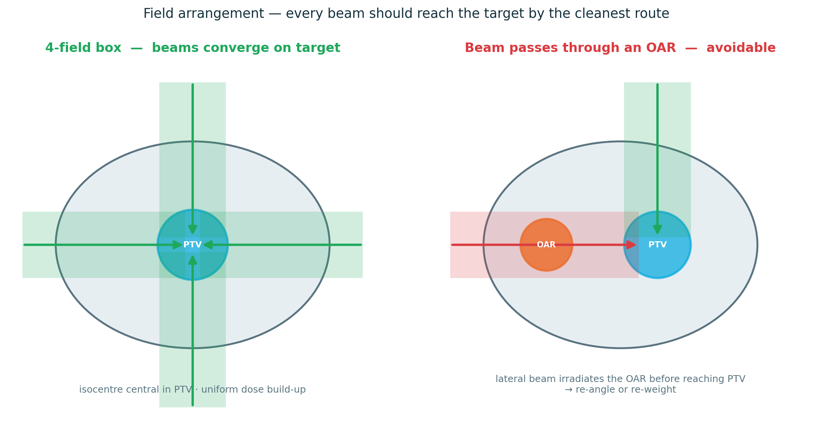
BLOCK 3 · TECHNICAL QUALITY
Technical red flags — patterns that signal a problem
Spot one of these — name it, explain the risk, say how to fix it.
▸ Isocentre in lung, air, or at a tissue interface — dosimetrically unstable
▸ A beam transiting directly through a critical OAR — do not enter or exit through a critical organ if a re-angle solves it
▸ Hot spot outside the PTV — in skin, bowel, or an organ at risk
▸ MLC clipped tight to the PTV — cold rim guaranteed; leaves no penumbra margin
Also watch for: no wedge on a sloping contour — cold strip at a field junction — implausible MU for the prescription
3DCRT PLAN EVALUATION / THEORY MODULE
21 / 34
Notes:
FIELD ARRANGEMENT — in 3DCRT this is the planner's primary lever, so spend real time here.
Unlike VMAT, where an optimiser sets things, in 3DCRT the planner explicitly chooses how many beams, from what angles, and how they are shaped and weighted. Beam geometry IS the plan. Three principles.
One — beams converge on the target from angles suited to the anatomy. The classic example, point at the left panel: the four-field box for a pelvic target — anterior, posterior and two opposed laterals. Four beams crossing at the target concentrate dose centrally while spreading the entry dose around the patient. Each beam pays an entrance-dose toll through normal tissue; converging from several directions shares that toll out and piles the useful dose where the beams overlap, on the target.
Two — avoid organs at risk. A beam should reach the target by the cleanest available route. If a simple change of gantry angle stops a beam ploughing straight through a critical organ, make that change. The right panel is the cautionary case: a lateral beam passing directly through an OAR before it ever reaches the PTV — irradiating that organ for no benefit. That is an avoidable geometry, and spotting it is exactly the kind of technical critique this block trains.
Three — understand the trade-offs. Opposed pairs — two beams 180 degrees apart — give homogeneous dose along their axis and are the building block of the four-field box. Adding more beams spreads the entrance dose more thinly, lowering skin and per-beam dose, but it irradiates more total tissue to low dose — the 'low-dose bath' enlarges. More beams is not automatically better; it is a trade between entrance dose and low-dose volume.
Evaluation habit: look at the beam's-eye-view and the angles, and for every beam ask two questions — does it have a sensible reason to come from that direction, and what does it pass through on the way in and on the way out.

Slide 23
BLOCK 3 · TECHNICAL QUALITY
Shaping the dose — weighting, wedges, modulation
Beam weighting
Wedges
The relative dose contribution of each field. Re-weight to pull the hot spot into the target and balance dose — e.g. AP/PA vs the laterals.
Physical or dynamic. Tilt the isodoses to compensate for a sloping surface or missing tissue — the classic use is breast tangents.
Field-in-field
Compensators
Forward-planned sub-segments that block emerging hot spots. The modern 3DCRT homogenisation tool — routine in breast.
Physical compensators or bolus to manage missing tissue and surface dose where wedges or segments are not enough.
3DCRT PLAN EVALUATION / THEORY MODULE
28 / 34
Notes:
THE MODULATION TOOLKIT — how a 3DCRT planner shapes dose once the beams are placed. Registrars should be able to recognise each of these on a plan and say why it is there.
Beam weighting. Each field can be given a different relative dose contribution — its weight, broadly its share of the monitor units. Weighting is how you fine-tune the distribution: shifting weight between the anterior-posterior pair and the laterals in a four-field box moves the high-dose region and lets you pull a hot spot back into the target or lift dose in a cold area. When you see an asymmetric weighting on a plan, it should have a reason — ask what the planner was correcting.
Wedges — physical wedges in the head, or dynamic 'wedges' produced by moving a jaw during delivery. A wedge tilts the isodose lines across the field. The primary use is to compensate for a sloping or curved patient surface, or for missing tissue, so that the dose stays even underneath. The textbook case is breast tangents: the breast contour falls away markedly, and without wedging you get a hot region where the tissue is thin and a cold region where it is thick. Wedges flatten that out.
Field-in-field — forward-planned sub-segments added on top of the open fields, each one shaped to block a region where a hot spot is emerging. This is the modern workhorse for 3DCRT homogenisation and is routine in breast planning. It is sometimes described as 'poor man's IMRT' — forward-planned, planner-controlled modulation rather than inverse-planned. If you see two or three little segments on a breast plan, that is field-in-field doing its job.
Compensators and bolus — physical compensators, or bolus laid on the skin, to manage missing tissue and to manipulate surface dose when wedges and segments are not sufficient. Bolus in particular is the tool for deliberately raising skin dose where the target is superficial.
The evaluation point: when a distribution looks good, look at HOW it was achieved. Appropriate wedges and field-in-field on a breast plan are a sign of careful planning. Their absence on a plan with an obvious sloping-contour hot spot is a flag — and that exact case is on the next-but-one slide.

Slide 24
BLOCK 3 · TECHNICAL QUALITY
Collimation & MLC shaping
The MLC and collimator shape each field to the beam's-eye-view of the target. Conform tightly — but never clip the PTV.
MLC conformance
Collimator rotation
Shape the field to the BEV of the PTV plus a penumbra margin. Too tight clips the target; too loose wastes normal tissue.
Rotate to match the field shape to the PTV, minimise the MLC “staircase”, and manage divergence at field junctions.
Penumbra margin
Tongue-and-groove
The MLC leaf edge is not the dose edge. Leave margin so the PTV sits inside the high-dose region, not in the falloff.
Slight underdose along leaf sides. Minimised by sensible collimator-angle choice — know it exists.
3DCRT PLAN EVALUATION / THEORY MODULE
29 / 34
Notes:
COLLIMATION AND MLC SHAPING — how each individual field is shaped.
Start with the beam's-eye-view concept: imagine looking out from the radiation source along the beam axis. From that viewpoint the target has a 2-D outline, and the job of the multi-leaf collimator — or, historically, custom blocks — is to shape the field to that outline so the beam treats the target and shields what is around it.
MLC conformance. Shape the field to the beam's-eye-view of the PTV PLUS a margin. The tension: conform too loosely and you irradiate normal tissue you did not need to; conform too tightly and you clip the PTV — the cause of that cold tail back in the Block 1 worked example. Conformance is a balance, not 'as tight as possible'.
Collimator rotation. The collimator can be rotated about the beam axis. You rotate it to make the rectangular leaf travel best match the orientation of the PTV — minimising the stepped 'staircase' the discrete leaves make against a smooth diagonal edge — and to manage beam divergence where one field abuts another at a junction. A sensible collimator angle is a small sign of a carefully built plan.
Penumbra margin — the single most important practical point here, so dwell on it. The MLC leaf edge is NOT the dose edge. Dose does not stop sharply at the leaf; it falls off gradually across the penumbra. So if you shape the MLC exactly to the PTV outline, the PTV edge ends up sitting in the penumbra — in the falling-off, under-dosed region — and you get an underdosed rim. You must add a margin between the leaf edge and the PTV so the whole PTV sits inside the flat, full-dose part of the field. This is, again, the cold-tail mechanism from Block 1, seen from the technical side.
Tongue-and-groove — the leaves interlock with a stepped tongue-and-groove edge to stop radiation leaking between them, and a side effect is a thin underdose stripe along the sides of the leaves. You manage it largely through collimator angle choice. For this course, you simply need to know it exists and what causes it — do not over-teach it.
Evaluation habit: look at the MLC shapes on the beam's-eye-views. Do they conform sensibly to the PTV with a believable penumbra margin — or are they clipped tight to the target outline, which predicts a cold rim you should then go and confirm on the slices.

Slide 25
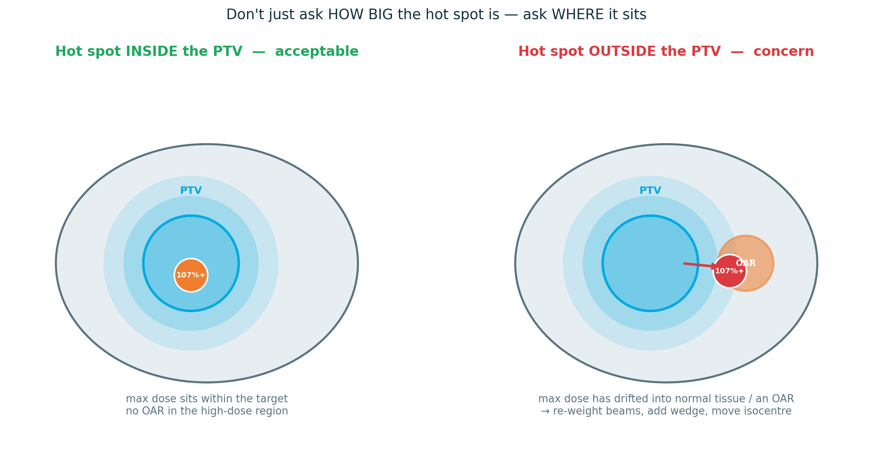
BLOCK 3 · TECHNICAL QUALITY
Hot spots, dose gradient & integral dose
Three final technical reads — and the first one is the most-missed.
▸ Hot spot — location, not just size a 107% inside the PTV is fine; in skin or an OAR it is not
▸ Dose gradient — dose should fall steeply between PTV and any adjacent OAR
▸ Integral dose / MU — sanity-check the monitor units; excess MU adds scatter and integral dose
The same hot spot is acceptable inside the PTV and a problem outside it
3DCRT PLAN EVALUATION / THEORY MODULE
30 / 34
Notes:
THE LAST TECHNICAL CONCEPTS — and the lead point is the single most common evaluation mistake registrars make, so make it land.
Hot spots — LOCATION, not just size. Registrars instinctively grab the maximum-dose number, see 108%, and worry. Wrong question. The right questions are: how big is the high-dose region — use D2%, the near-max, not a single-voxel Dmax — and, far more important, WHERE is it. Point at the diagram. A 107-plus-percent hot spot sitting inside the PTV is generally fine — that is target tissue, and a little extra dose to the tumour is not a problem. The very same hot spot sitting in skin, or in an organ at risk, or in normal tissue outside the PTV, is a real concern — that is healthy tissue being overdosed. So the rule: never report a hot spot by magnitude alone; always pair it with its location. And this is precisely the gap the facilitator notes warn about — registrars over-weight hot spots as a number and under-weight WHERE dose actually lands.
Dose gradient — how rapidly dose falls off in space. Between the PTV and an adjacent OAR you want a STEEP gradient: full dose on the target, dropping away fast so the neighbouring organ is spared. A lazy, shallow gradient there means the OAR is sharing the high-dose region. So when a target sits hard against a critical organ, look specifically at the gradient on the slices in that gap — it is where conformity becomes concrete.
Integral dose and monitor units. Integral dose is, loosely, the total energy deposited in the patient — all the dose, everywhere, not just on the target. You cannot drive it to zero, but you should not inflate it needlessly. Sanity-check the monitor units: an implausibly high MU, or a very low-weighted field dragging MU up for almost no dosimetric benefit, adds scatter dose throughout the patient and raises integral dose — which carries a second-malignancy consideration, especially in younger patients. A quick MU plausibility check is part of a complete technical evaluation.
That closes the technical concepts. Next slide pulls it together as a critique exercise.

Slide 26
BRINGING IT TGETHER
The scorecard, revisited
You now have the concepts. Sort them into the three tiers — that sorting is the clinical skill.
CRITICAL
REJECT ON SIGHT IF…
Plan fails — re-plan
Geographic miss of the target · serial OAR over a hard tolerance · hot spot in a critical organ.
1
The target will be missed
cold dose reaching into the CTV — not just the PTV margin
MAJOR
Correct it or justify it
2
A critical serial organ exceeds a hard tolerance
Parallel-OAR mean over constraint · coverage V95 90–95% · a beam through an avoidable OAR.
cord, brainstem, chiasm
3
The plan is unsafe or undeliverable
MINOR
Comment — rarely decisive
it cannot be delivered as drawn
Slightly high MU · minor inhomogeneity · a non-ideal but workable isocentre.
Everything else is graded discussion — not a free pass.
3DCRT PLAN EVALUATION / THEORY MODULE
22 / 34
Notes:
CONSOLIDATION — bring Block 4's scorecard exercise full circle. This is where the registrars compare their own scorecard against the ideal.
The message: they now hold all the concepts — coverage, conformity, homogeneity, OAR constraints, serial-versus-parallel, dose-response, technique. A flat list of all of it is not yet a scorecard. The clinical skill is SORTING those concepts into the three tiers. The sorting IS the competence.
Walk the tiers with concrete examples. CRITICAL — the plan fails, the answer is re-plan, not a footnote: a geographic miss of the target, cold dose reaching into the CTV; a serial OAR over a hard tolerance, cord or brainstem or chiasm; a hot spot sitting in a critical organ. MAJOR — a real consequence that must be corrected or explicitly justified: a parallel-organ mean dose over its constraint, coverage that has slipped to V95 of 90-95%, a beam passing through an OAR that a re-angle could have avoided. MINOR — worth a comment, rarely decisive: slightly high monitor units, minor inhomogeneity, an isocentre that is not ideal but workable.
Now spend real time on the right-hand panel — REJECT ON SIGHT. This is the exact anchor question from the start of the module: name the findings that make you reject a plan outright. After the whole module, here is the disciplined answer — three reasons. One, the target will be missed — cold dose reaching into the CTV, not merely softness at the PTV margin. Two, a critical serial organ exceeds a hard tolerance — cord, brainstem, chiasm. Three, the plan is unsafe or simply cannot be delivered as drawn.
The teaching point underneath: notice how SHORT that list is. Only three things are true reject-on-sight failures. Everything else — every other finding in this module — is graded discussion. Graded discussion does not mean unimportant; it means it is weighed, justified and documented rather than being an automatic fail. Registrars tend to invert this: they treat hot spots and minor inhomogeneity as catastrophes and under-weight the genuine critical failures. A registrar who can name those three, and calmly grade everything else, is evaluating plans like a clinician.
Close: have them mark up their own scorecard — every line tagged critical, major or minor — and we will compare against the ideal.

Slide 27
PUTTING IT TO WORK
A repeatable evaluation routine
Same sequence, every plan, every time — then the handful of habits that catch the errors checklists miss.
REVIEW IN THIS ORDER
Visual review before the DVH
1
Prescription
Scroll the isodoses on every plane first — the DVH cannot tell you WHERE.
2
Contours
The DVH confirms, never replaces
3
Beam arrangement
Use it to verify what the images already showed you — not instead of them.
4
Isodose — visual
5
Coverage
Fix problems in the right order
6
Hot / cold spots
Contours → geometry → normalisation → optimisation → fine-tune. Never start with objectives.
7
DVH
8
Organs at risk
Robustness, not perfection
9
Final Clinical decision
Ask what happens if the patient shifts or the bladder fills — a slightly less ‘perfect’ plan can be safer.
3DCRT PLAN EVALUATION / THEORY MODULE
23 / 34
Notes:
THE PRACTICAL CONSOLIDATION — this is what registrars actually take to the workstation.
The left column is the fixed review sequence. Prescription first — always — then contours, beam arrangement, a visual isodose review, coverage, hot and cold spots, then the DVH, then OARs, and finally the decision. The single most important thing about this list is not its content but its FIXEDNESS: using the identical order on every plan is itself an error-reduction tool, because the step you are tempted to skip on a busy day is exactly the step that hides the problem. Note this sequence is simply FCB-CHOPS reorganised into a workflow — prescription pulled to the front, decision added at the end.
The right column is four habits that catch what a checklist alone misses. One — look at the plan visually before you open the DVH; the DVH has thrown away all spatial information, so the images must come first. Two — use the DVH to CONFIRM the visual impression, never to replace it; a good-looking DVH over a bad distribution is a trap. Three — when something is wrong, fix it in the correct order: contours, then geometry, then normalisation, then optimisation, then fine-tuning. Registrars instinctively jump straight to tweaking optimiser objectives — that just compensates for an upstream error instead of correcting it. Four — evaluate robustness, not perfection: a plan that still works when the patient is a few millimetres off, or the bladder fills differently, is genuinely better than a fragile plan that only looks perfect on the planning scan.

Slide 28
WRAP-UP
Key takeaways & references
A good plan is a documented compromise
REFERENCES & FURTHER READING
Target covered, OARs within tolerance, technically sound, deliverable — and every trade-off articulated.
FCB-CHOPS — Weisman et al., 2024
Adv Radiat Oncol — the plan-evaluation framework
ICRU Reports 50, 62 & 83
Volume definitions and dose reporting
The DVH screens; the slices diagnose
It has no spatial information. Always confirm where the cold and hot regions actually sit.
QUANTEC
IJROBP 2010;76(3) Suppl — OAR dose–volume constraints
Emami et al., 1991
IJROBP 21(1):109–122 — original tolerance table
Match the metric to the organ
Architecture — serial or parallel — decides whether you read Dmax or mean dose.
HyTEC
Constraints for hypofractionation & SBRT
RTOG / NRG protocols
Site-specific, trial-vetted constraint sets
Prioritise — not every deviation is equal
Three reject-on-sight failures; everything else is graded, justified discussion.
Khan, Treatment Planning in Radiation Oncology
Standard planning text
3DCRT PLAN EVALUATION / THEORY MODULE
24 / 34
Notes:
CLOSE THE MODULE. Two minutes — land the four takeaways, point at the references, hand over to the scorecard work.
Takeaway one — a good plan is a documented COMPROMISE. Not perfect; defensible. The target covered, the organs at risk within tolerance, the plan technically sound and genuinely deliverable — and every trade-off made along the way articulated and recorded. If a registrar leaves with one sentence, this is it.
Takeaway two — the DVH screens, the slices diagnose. The DVH is the indispensable first tool, but it has thrown away all spatial information. It tells you THAT something is cold or hot, never WHERE. Every real evaluation ends on the axial slices confirming where the dose actually sits. This came up in every single block — make it stick.
Takeaway three — match the metric to the organ. Before reading any OAR number, ask: serial or parallel? That architecture tells you whether the maximum dose or the mean dose is the number that matters. It is the difference between understanding a constraint and merely reciting it.
Takeaway four — prioritise. Not every deviation is equal. Three findings are reject-on-sight; everything else is graded, justified, documented discussion. The triage is the clinical skill the whole module — and the scorecard exercise — has been training.
References — these are the primary sources behind everything we covered, and they are worth knowing by name for exams as well as for practice. ICRU 50, 62 and 83 for the volume definitions and dose-reporting language. QUANTEC, the 2010 Red Journal supplement, for organ-at-risk dose-volume constraints — the everyday reference. Emami 1991 as the historical origin of tolerance tables. HyTEC for the hypofractionation and SBRT era. RTOG/NRG and national protocols for site-specific, trial-vetted constraints — always plan to the named protocol. And Khan's Treatment Planning in Radiation Oncology as the standard planning textbook to go deeper.
Hand-off line: "That is the theory. From here you are scoring real plans — five sites, your own scorecard against the ideal. Everything we have built today is now a tool in your hands." Then move to the site work.

Slide 29
YOUR TASK TODAY
Complete the score card as you review each plan
The skill we are training is triage - the score card tool structures your thinking so the case review is richer.
CRITICAL
MARGINAL
PASS
BEFORE CASE REVIEW
Reject
Comment
Approve
"What are your top three concerns with this plan?"
Unsafe dose or missed target. Needs re-plan.
Acceptable but improvable. Flag and discuss.
Meets all criteria. Record and move on.
Complete the score card tool before the group discussion opens.
Naming your top three concerns first separates critical from minor thinking before any ideal answer is shown.
IN THE SCORE CARD TOOL
Score each parameter: Pass / Marginal / Fail - and add a free-text note for each finding.
Your completed scorecard will anchor the case review discussion that follows.
3DCRT PLAN EVALUATION / THEORY MODULE
25 / 34
Notes:
SET UP THE EXERCISE THAT RUNS THROUGH THE WHOLE COURSE.
The deliverable is a scorecard — but the learning objective is prioritisation. Make this explicit: a flat checklist of 30 items treats a 2 mm isocentre offset the same as a geographic miss of the tumour. That is useless at the workstation. The clinical skill is triage.
Three tiers. CRITICAL — the plan fails; it is unsafe or the target is missed; the answer is re-plan, not 'note and proceed'. MAJOR — a real clinical consequence; it must be corrected or there must be an explicit, documented reason it is acceptable. MINOR — suboptimal but not unsafe; worth a comment, rarely changes the decision.
The scoring scale is deliberately three points — Pass / Marginal / Fail. A two-point pass/fail hides the borderline plans where the real teaching is; a five-point scale invites fence-sitting. Three points force a call while still flagging 'marginal' for discussion. Insist on a free-text box on every scorecard — intent (radical vs palliative), previous radiotherapy, comorbidity and patient-specific trade-offs never fit a tick-box.
THE FACILITATION MOVE on the right is the most important thing on this slide. Before you ever show an ideal scorecard, give them five quiet minutes and ask for their top three reject-on-sight findings. Starting from the top three — rather than building up from trivia — trains critical-versus-minor judgement from the first second. We return to this exact anchor at the end of the module.

Slide 30
04
Case Reviews
90 MINUTES
Case 1: Breast
Case 2: Gynae
BLOCK FOUR
Case 3: Prostate
Case 4: Neuro
Case 5: Head & Neck
3DCRT PLAN EVALUATION / PRACTICAL MODULE
26 / 35
Notes:
BLOCK 3 — TECHNICAL QUALITY. Ten minutes.
Transition: "Blocks 1 and 2 judged the plan by its outcomes — the dose to the target and the dose to the organs. Block 3 looks under the bonnet at HOW the plan was built."
Frame why this block matters even though the DVH already 'passed'. A plan can hit every coverage and OAR number and still be technically poor — fragile, inelegant, or built in a way that will not survive contact with reality. Technique is also where you most clearly see whether a plan was thoughtfully constructed by a planner or simply churned out. And — pull it forward to the Block 2 example — many coverage and OAR failures are technical problems wearing a DVH disguise; learn to see the cause, not just the symptom.
Preview: isocentre placement, then beam angles and field arrangement, then the modulation tools — weighting, wedges, collimation, MLC shaping — then hot spots, dose gradient and integral dose. This is the most 3DCRT-specific block; the concepts are concrete and visual, so lean on the diagrams.

Slide 31
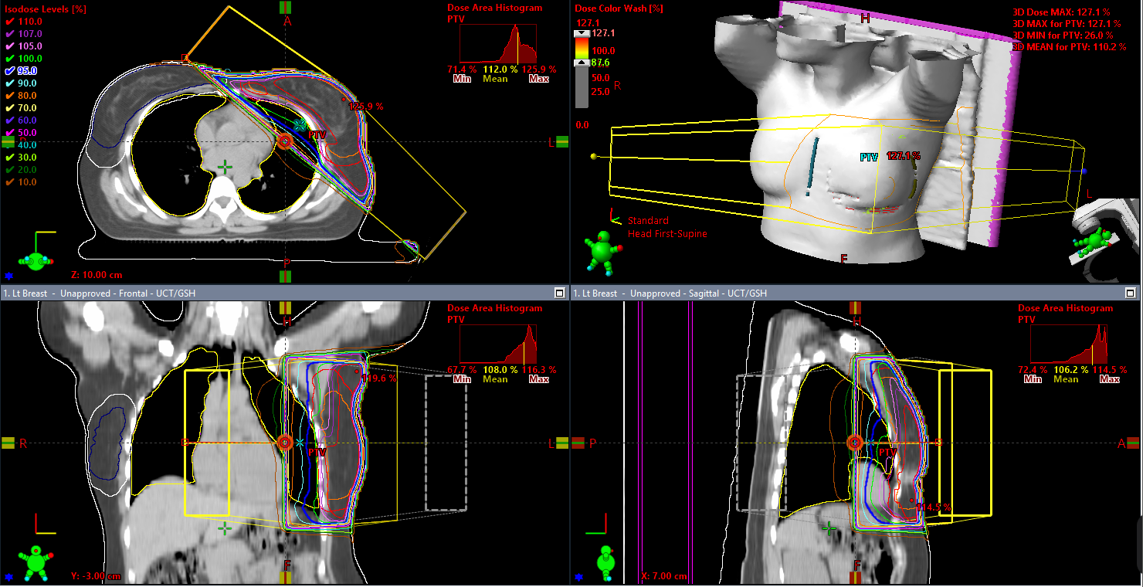
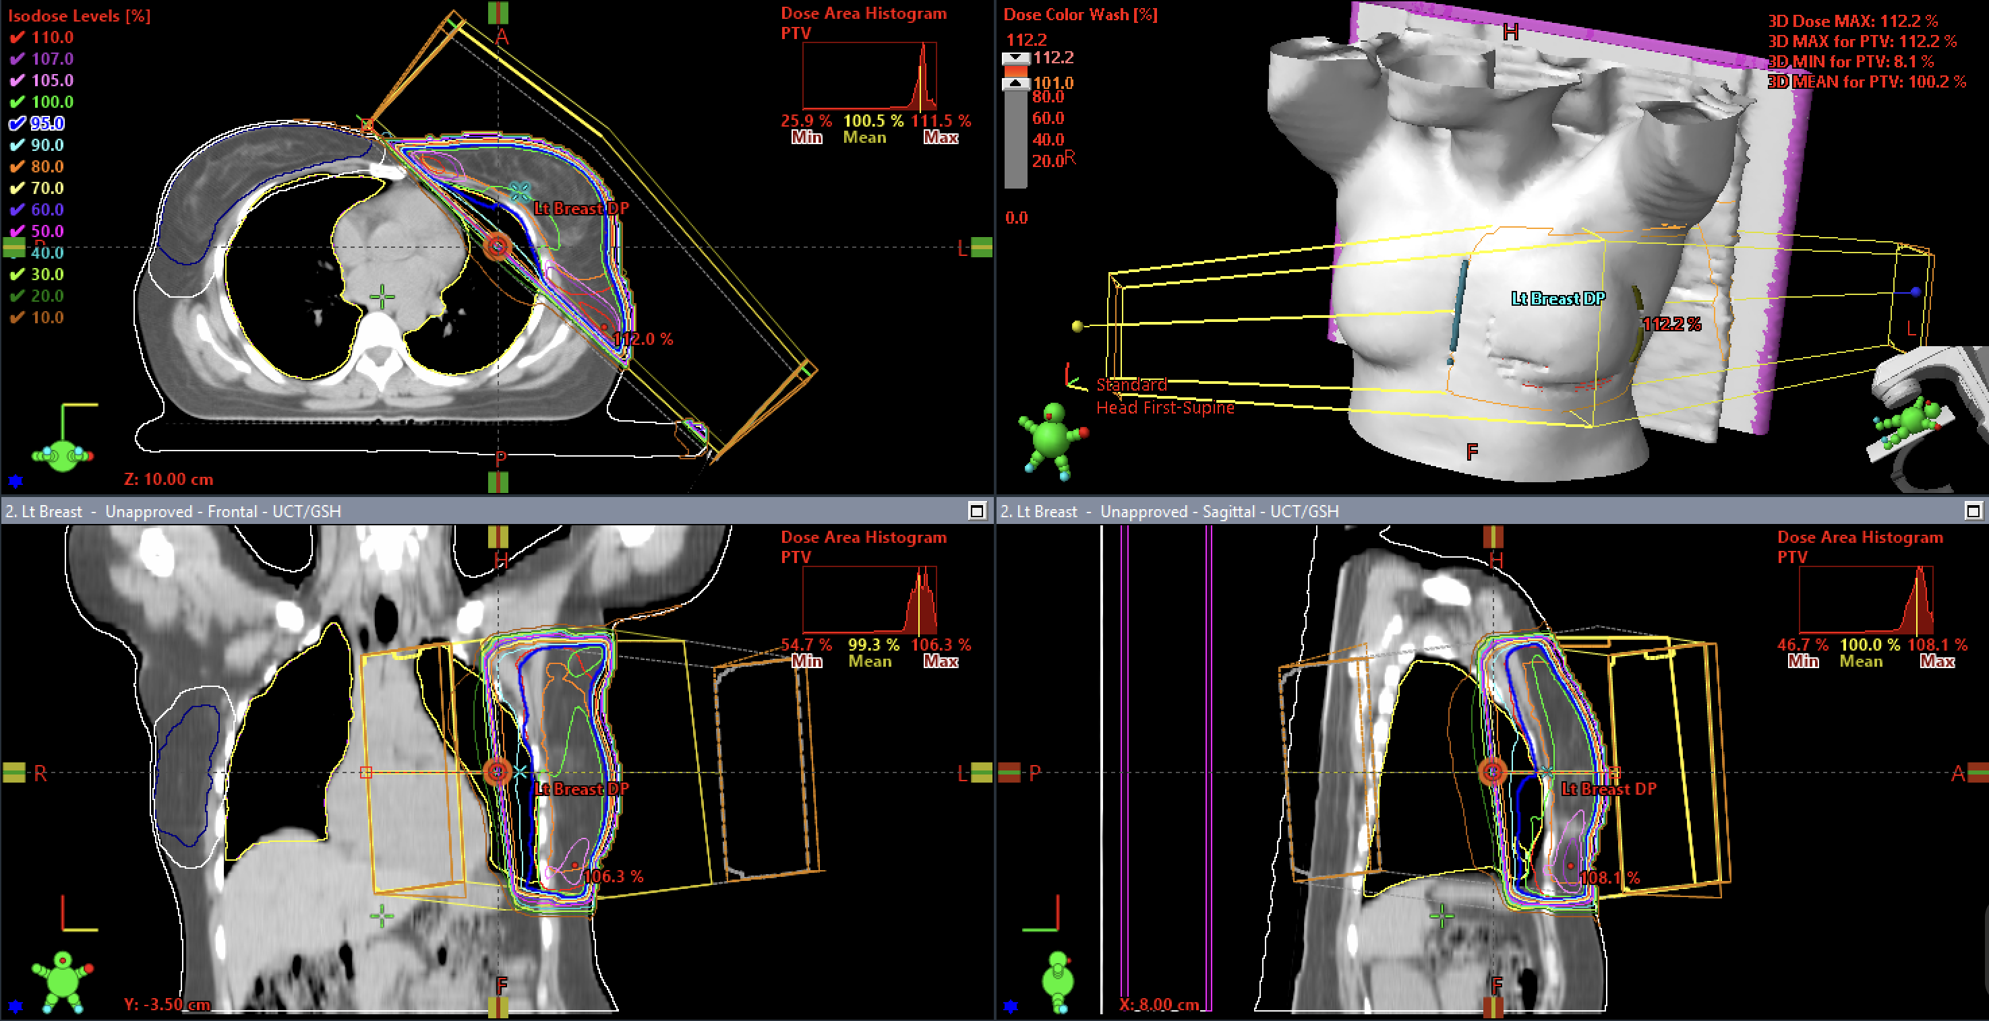
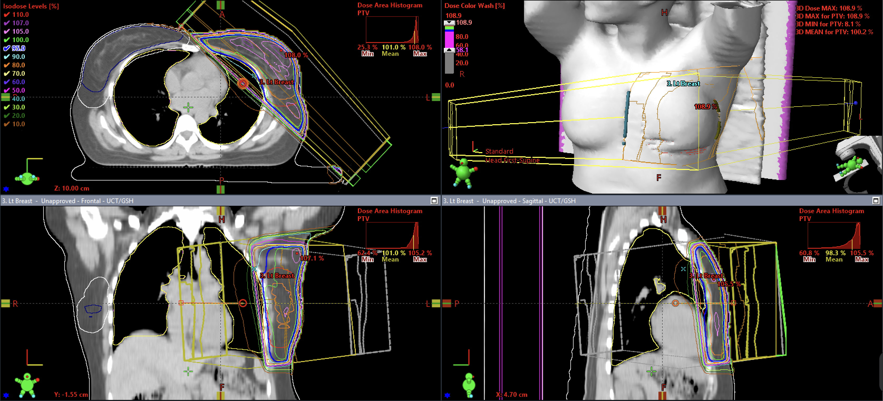
BLOCK 4 · CASE REVIEWS
Case 1: Breast
Bad Plan
Acceptable Plan
Good Plan
No Wedges
Wedged
FiF
Poor iso placement (too deep into lung & heart)
Crossing midline (unnecessary contralateral dose)
No flash applied (under coverage of superficial breast tissue)
Poor normalization point placement (in lung)
Unacceptable hotspot value (>115%) and location
No dose shaping, poor homogeneity
Heart exceeding tolerance
Good iso placement
In midline (contralateral spared)
Flash applied ( 2cm beyond breast tissue for superficial breast coverage, breathing & set up error)
Good normalization point placement, good coverage
Acceptable hotspot value (<115% ) and location
Wedges applied, improved homogeneity
Heart & Lung within tolerance
Good iso placement
In midline (contralateral spared)
Flash applied ( 2cm beyond breast tissue for superficial breast coverage, breathing & set up error)
Good normalization point placement, good coverage
Acceptable hotspot value (<110%) and location
Selective reduction of hotspots using subfields
Heart & Lung within tolerance
3DCRT PLAN EVALUATION / PRACTICAL MODULE
27 / 34

Slide 32
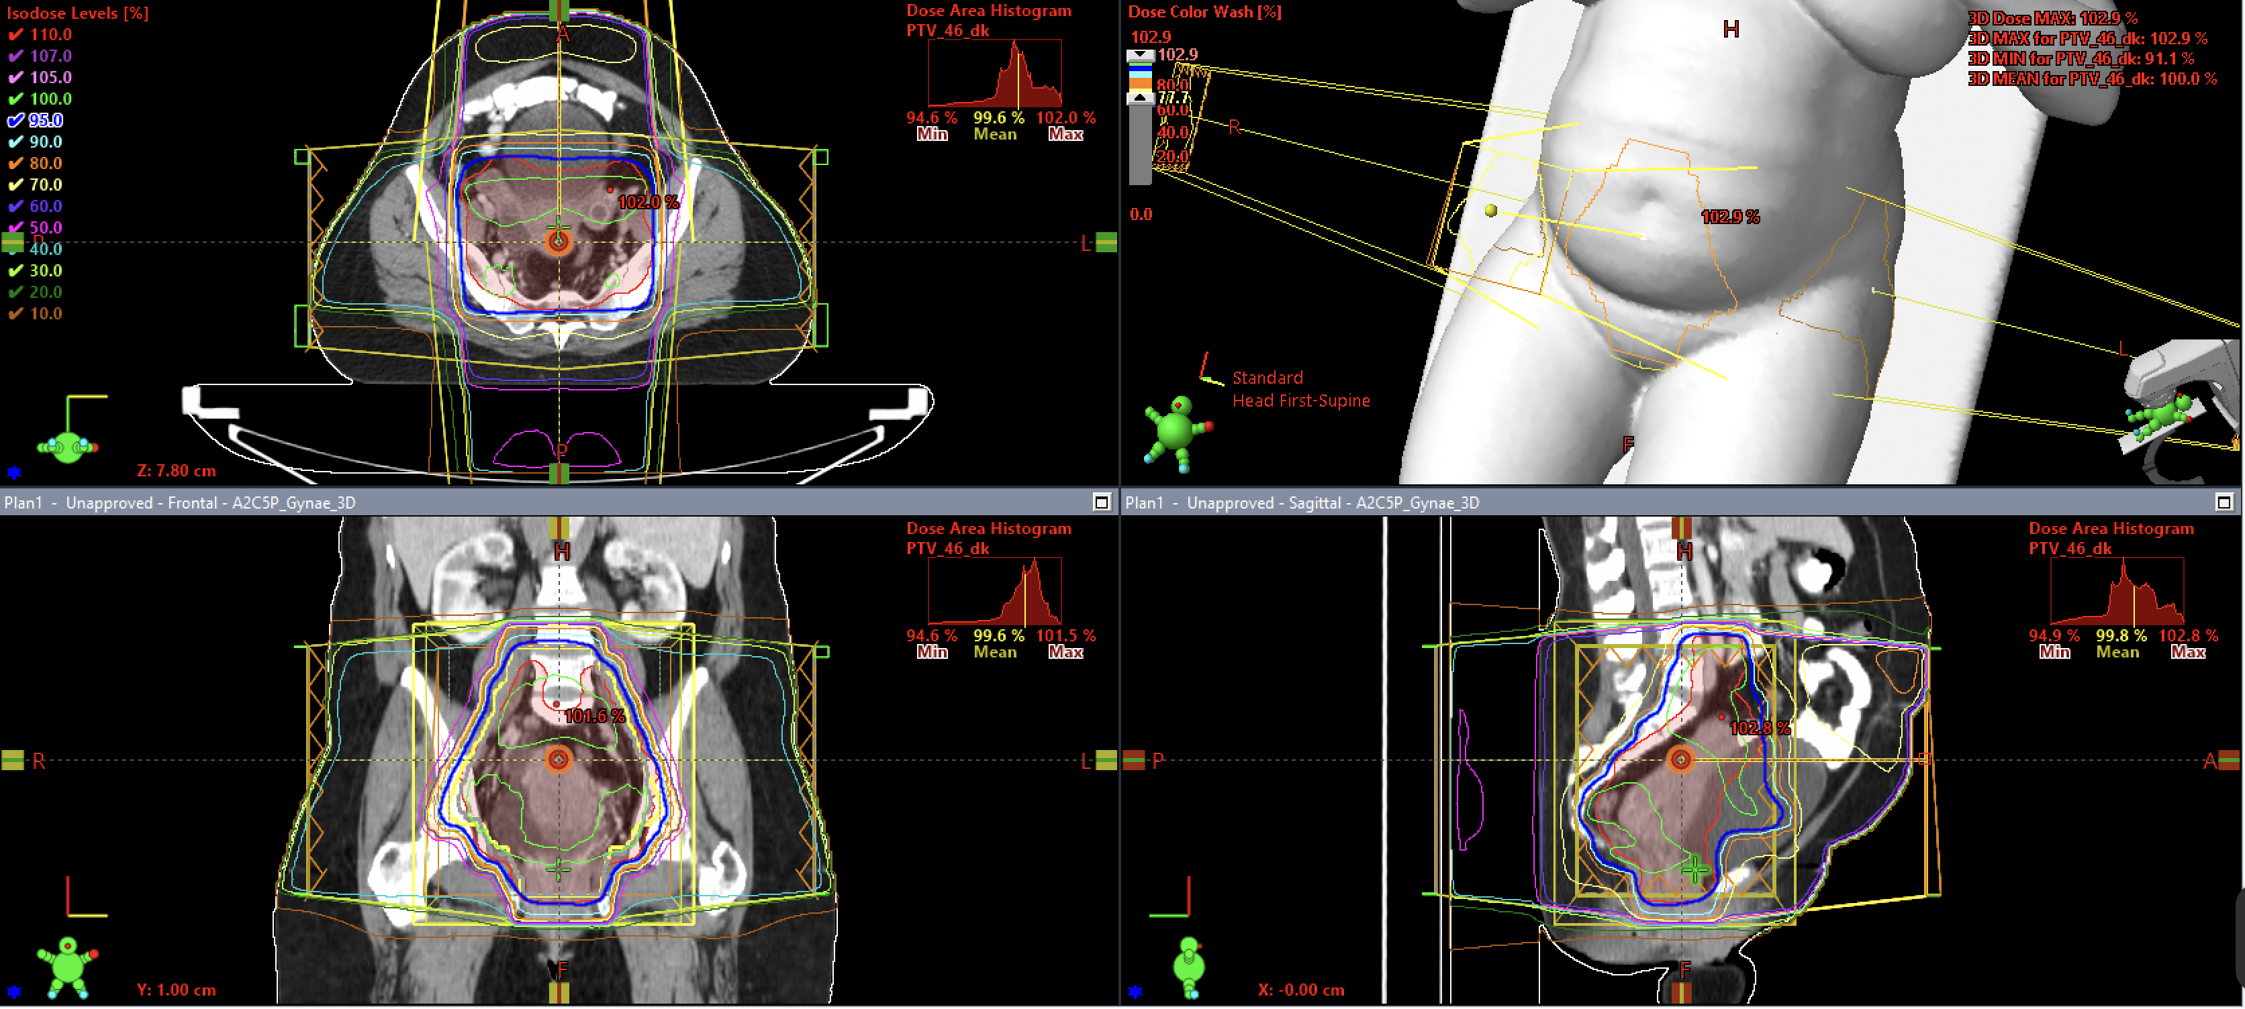
BLOCK 4 · CASE REVIEWS
Case 2: Gynae
Trade Off Plan
4 Field Box (FiF)
PTV coverage → – good and maintained
Rectum dose → ↑ exceeds tolerance (e.g. V45 / V30)
High dose region extends into posterior pelvis (rectum region)
Dose distribution driven by anterior–posterior beam contribution
Other OARs (bladder, bowel, etc.) → – within acceptable limits
Improving rectum dose would compromise target coverage
Current plan prioritises coverage over rectum sparing
No clear way to improve both without introducing a compromise
3DCRT PLAN EVALUATION / PRACTICAL MODULE
28 / 34

Slide 33
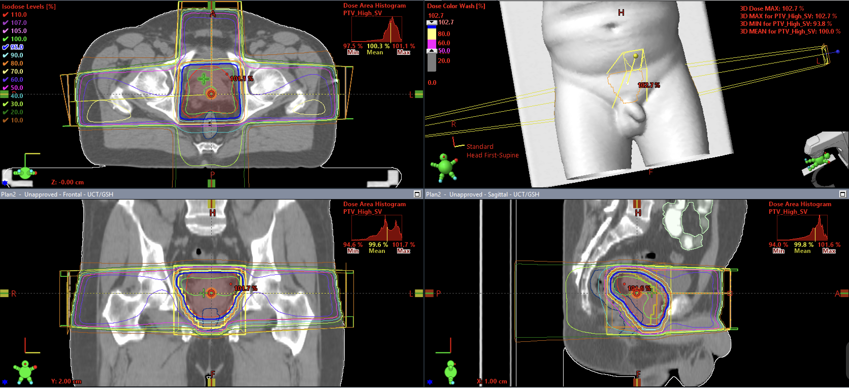
BLOCK 4 · CASE REVIEWS
Case 3: Prostate
PTV coverage → – good and maintained (CTV D98 ≈ 99.2%, PTV D98 ≈ 96.6%)
Rectum dose → ↑ exceeds tolerance (V55 ≈ 37.9%, V59 ≈ 32.9%)
Penile bulb mean ≈ 62.8 Gy → ↑ significantly above tolerance
Small bowel → mostly within limits, with minor focal exceedance (V52)
Bladder → – well controlled and within all constraints
Femoral heads → – within tolerance
Reducing rectum / penile bulb dose would compromise target coverage ⚖️
Plan prioritises target coverage over posterior OAR sparing
Requires clinical decision — not simple optimisation
Trade Off Plan
3 Field
3DCRT PLAN EVALUATION / PRACTICAL MODULE
29 / 34

Slide 34
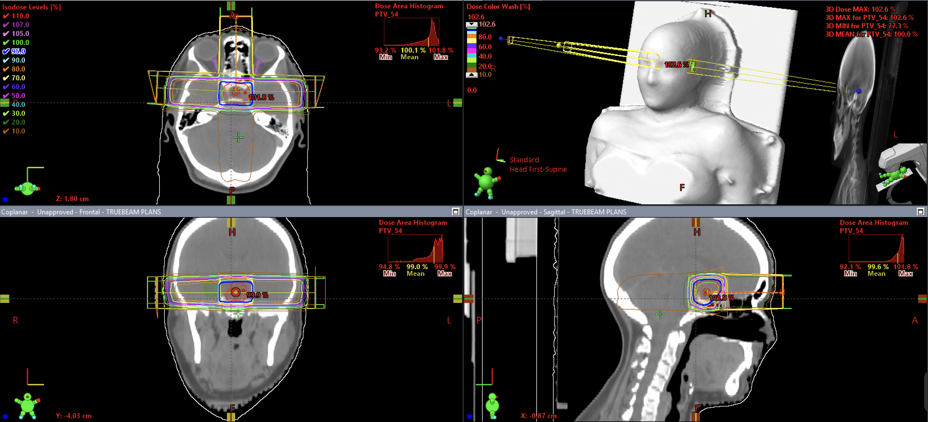
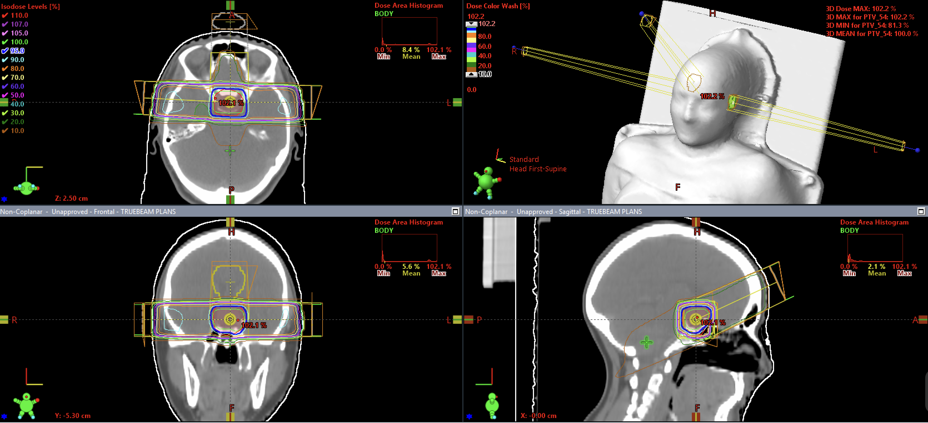
BLOCK 4 · CASE REVIEWS
Case 4: Neuro
Acceptable Plan
Good Plan
Coplanar
Non-Coplanar
PTV min = 41.75 Gy → inferior coverage still reduced
Optic chiasm max = 54.9 Gy → high but acceptable
Optic nerves ~53 Gy max → reasonable
Brainstem max = 52.5 Gy, mean ~11 Gy → acceptable
Air region under coverage (88.7%) → physics-driven
No major planning errors – clinically deliverable
Improvement achievable with alternative beam arrangement
PTV min = ~43.9 Gy → improved inferior coverage (↑ ~2.1 Gy)
Optic chiasm max ≈ ~54.9 Gy → similar (no meaningful change)
Optic nerves max ≈ ~53 Gy → similar, with slight improvement in mean dose (especially R - ↓~2Gy )
Brainstem max ≈ ~52.1 Gy, mean ~9.7 Gy → reduced mean dose (↓ ~1.6 Gy )
Air region under coverage (~88.7%) → unchanged, physics-driven
Plan reflects optimal use of geometry to manage anatomical limitation
Improvements achieved without compromising other structures
3DCRT PLAN EVALUATION / PRACTICAL MODULE
30 / 34

Slide 35
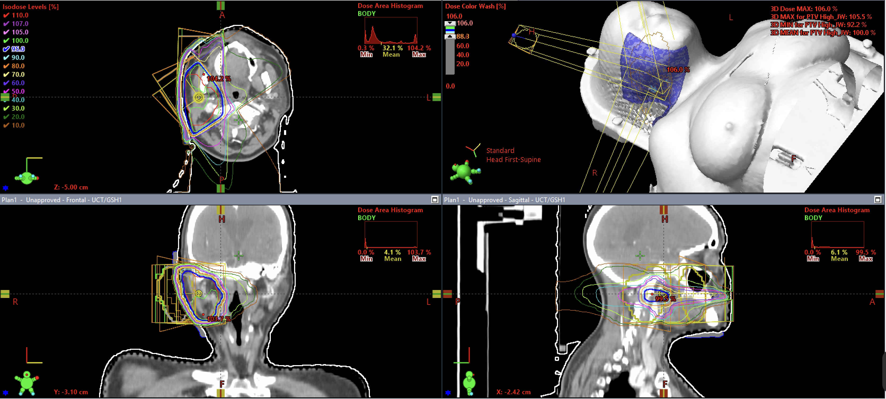
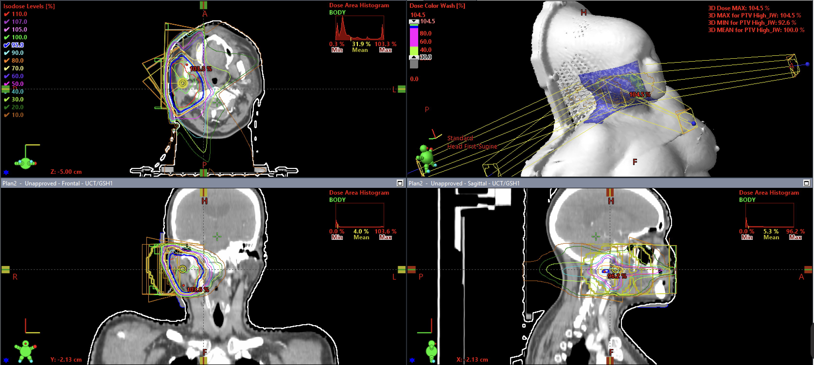
BLOCK 4 · CASE REVIEWS
Case 5: Head & Neck
Acceptable Plan
Good Plan
4-Field Plan
3-Field Plan
Target coverage (PTV High) mean ≈ 66.0 Gy → – acceptable
Contralateral parotid (L) mean ≈ 3.30 Gy → ↑ higher dose (less sparing)
Spinal cord max ≈ 19.9 Gy → – within tolerance
Brainstem max ≈ 18.2 Gy → – within tolerance
Oral cavity mean ≈ 17.2 Gy → – similar
Submandibular gland (R) mean ≈ 40.4 Gy → ↑ higher dose
No major planning errors – clinically deliverable
Improvement achievable with alternative beam arrangement
Target coverage (PTV High) mean ≈ 66.0 Gy → – maintained
Contralateral parotid (L) mean ≈ 1.14 Gy → ↓ improved sparing (~2.2 Gy reduction)
Spinal cord max ≈ 17.8 Gy → ↓ lower dose (~2 Gy reduction)
Brainstem max ≈ 16.1 Gy → ↓ lower dose (~2 Gy reduction)
Oral cavity mean ≈ 17.2 Gy → – similar
Submandibular gland (R) mean ≈ 40.0 Gy → ↓ slight improvement
Plan reflects optimal use of geometry to manage anatomical limitation
Improvements achieved without compromising other structures
3DCRT PLAN EVALUATION / PRACTICAL MODULE
34 / 34
Notes:
(~1.6 Gy improvement

